Slide 1
MR Physics and Instrumentation Group
Guidelines for open-source shim amplifier setup
Update: December 1, 2018
Jason Stockmann
A. A. Martinos Center for Biomedical Imaging
Massachusetts General Hospital
email questions to: jstockmann@mgh.harvard.edu

Slide 2
Open-source shim amplifier board circuit board files, schematics, and simulation software available here:
http://rflab.martinos.org/index.php/Current_driver:Current_driver
Bill of materials / parts list for the three circuit boards is also available:
8ch amplifier board
Teensy 3.5 Microcontroller daughter board / fiber optic board
Fiber optic interface board
In the following few slides, we provide suggested parts to use for the remaining components of the amplifier setup, including AC/DC converter power supply, enclosures, cabling, etc.
We also list the parts on the 8ch amplifier boards that don’t come pre-populated on the boards supplied with the open-source kit.

Slide 3
Subsystem | Part name | Suggested part number | Link | Cost ($ USD) | Notes
Switching Power supply | AC/DC converter, 2000W Single Output Power Supply 12 Volts @ 100 Amps | RSP-2000-12 | https://www.jameco.com/z/RSP-2000-12-MEAN-WELL-2000W-Single-Output-Power-Supply-12-Volts-100-Amps_2152981.html?CID=GOOG&gclid=CjwKCAjwrNjcBRA3EiwAIIOvq4hT5vFfBLhiGqZbjJncPI57JO-Bi-CI3hmqy6vK_Mqv8c29MJvcvRoClx8QAvD_BwE | 375 | Another good option if you only need 50 amps: https://www.jameco.com/z/SE-600-12-MEAN-WELL-AC-to-DC-Power-Supply-Single-Output-12-Volt-50-Amp-600-Watt_374011.html
 | Bud Industries rack-mount Enclosure (13”x17”x3.5”) | 563-NHC-14155 | https://www.mouser.com/ProductDetail/Bud-Industries/NHC-14155?qs=%2fha2pyFaduj9zMZIBX%252bDj2IzVART0WEz1YCyw2YIou8%3d | 109 | Meanwell AC/DC 12V/100A is a tight fit in this enclosure.
 | Simpson DC Ammeter (0-100A) | 02740 | https://www.mouser.com/ProductDetail/Simpson-Electric-Company/02740?qs=sGAEpiMZZMtUpMOmSPzkHy4N5Z8yXGvg | 96 | Can also use slightly smaller 02540 model.
 | Current shunt, Analog Panel Meters SHUNT 100 AMP 50 MV | 06713 | https://www.mouser.com/ProductDetail/Simpson-Electric-Company/06713?qs=sGAEpiMZZMtFJx2zDaGuWCGrWWAP9a5liEaW4QXVCq4%3d
Linear power supply option | AC/DC CONVERTER 13.8V 828W | TL241-ND | https://www.digikey.com/product-detail/en/tripp-lite/PR60/TL241-ND/251533 |  | A linear supply is an alternative to a switching supply if RF noise is a concern. The linear supply has “clean” output power so a filter panel might not be required. Common mode chokes should still be used on the cables running from the linear supply into the magnet room. If ferrous chokes are used, be careful to keep them outside the magnet room.
Shim amplifiers | OPA549, IC OPAMP POWER 900KHZ TO220-11 | OPA549T-ND | https://www.digikey.com/product-detail/en/texas-instruments/OPA549T/OPA549T-ND/307860 | 23 | Two power op amps needed for each channel (16 per board)
 | Power connector (10-pin MOLEX) | WM21355-ND | https://www.digikey.com/products/en?keywords=WM21355-ND |  | Mating connector for internal enclosure cabling: https://www.digikey.com/product-detail/en/molex-llc/39-01-2100/WM3704-ND/61385
 | Output connector (2-pin MOLEX) | WM21351-ND | https://www.digikey.com/products/en?keywords=WM21351-ND |  | Mating connector for internal enclosure cabling: https://www.digikey.com/product-detail/en/molex-llc/39-01-2020/WM3700-ND/61315
 | Pins for Mini-Fit Jr. connectors | WM2501CT-ND | https://www.digikey.com/product-detail/en/molex-llc/39-00-0038/WM2501CT-ND/467978 |  | Contacts for AWG18-24 for Mini-Fit Jr. MOLEX connectors for internal wiring inside amplifier enclosure
 | Crimp tool for Mini-Fit Jr. MOLEX | 63819-0900 | https://www.newark.com/molex/63819-0900/hand-crimp-tool/dp/97M9440?MER=bn_level5_5NP_EngagementRecSingleItem_1 | 281

Slide 4
Subsystem | Part name | Suggested part number | Link | Cost ($ USD) | Notes
Cabling | Shim output cable
 | Power cable to amplifiers
 | Twisted pair cable Option 1

Slide 5
Subsystem | Part name | Suggested part number | Link | Cost ($ USD) | Notes
ODU connectors. |  |  | https://www.odu-usa.com/fileadmin/redaktion/downloads/downloadcenter/brochures/ODU-MAC_ZERO_Manual_Mating-0518.pdf |  | Helpful contacts at ODU who can help you purchase the correct part numbers: Hauger John John.Hauger@odu-usa.com Lowe Tom Tom.Lowe@odu-usa.com ODU Zero high-density connectors are available with 42-pin (21 channels) and 90-pin (45 channels) options for each connector. See online documentation for more details.
MIL-SPEC connectors | Male box-mount connector | MS3112E20-16P | https://www.mouser.com/ProductDetail/Amphenol-Industrial/MS3112E20-16P?qs=sGAEpiMZZMv%2fye0hRulZR%2fS5ltx8gSydeTjLcqhhYqo%3d | 37 | To use as 12V power input connector for the amplifier board enclosure
 | Circular MIL Spec Connector 16P #16 SKT CONTACTS | MS3116F20-16S | https://www.mouser.com/ProductDetail/Amphenol-Industrial/MS3116F20-16S?qs=sGAEpiMZZMv%2fye0hRulZR%2fS5ltx8gSydZaYg9yxXhSg%3d | 80 | To connect to male box-mount connector on amplifier board enclosure for 12V power input (must make custom cable using this part)
 | Circular MIL Spec Connector 16P Size 20 Pin Plug Strt Strain Relief | PT06E-20-16P-SR | https://www.mouser.com/ProductDetail/Amphenol-Industrial/PT06E-20-16P-SR?qs=%2fha2pyFadugSneYzzMZUg8xUloEPQyyBQexzX6MEOBwLIRvnztMUBQ%3d%3d | 62 | To connect to 12V power supply output box-mount connector (must make custom cable using this part)
 | Female box mount connector | PT06E-20-16P-SR | https://www.mouser.com/ProductDetail/Amphenol-Industrial/PT06E-20-16P-SR?qs=%2fha2pyFadugSneYzzMZUg8xUloEPQyyBQexzX6MEOBwLIRvnztMUBQ%3d%3d
Cooling System | Lytron Ambient Cooling System (rack-mount version) | MCS20G01BB | https://www.lytrondirect.com/mcs20g01bb-ambient-cooling-system/ | 1400
 | Lytron cold plate (6-pass), 12”x3.8”, ¼” thick | CP15G05 | https://www.lytrondirect.com/cp15g05-tubed-cold-plate/cp15g05/ | 167 | Carefully drill holes in this cold plate for mounting OPA549 op amps. Put thermal grease between op amps and aluminum cold plate.

Slide 6
Subsystem | Part name | Suggested part number | Link | Cost ($ USD) | Notes
Plumbing (Swage-Lok) | Brass hose tube adapter 1/4 | B-4-HC-A-401
 | Vinyl tubing | LT-8-10 |  |  | Vinyl Tubing, 1/2 in. ID - 5/8
 | Brass Reducer, 1/4 in. OD | B-400-R-8
 | Brass Hose Tube Adapter, 1/2 i | B-8-HC-A-811
 | Brass Quick Connect Bulkhead B | B-QC8-B1-810
 | Brass Quick Connect Stem, 1/2 | B-QC8-D-810
Filter (to be continued…) | Schaffner 200 amp filter capacitor | FN 7563-200-M10 | https://www.digikey.com/products/en?FV=ffec4bdd |  | Be sure to filter both the input power line and return path. Use filter capacitor that is mounted to the faraday shield of the magnet room.
 | Schaffner 100 amp filter capacitor | FN 7563-100-M8

Slide 7
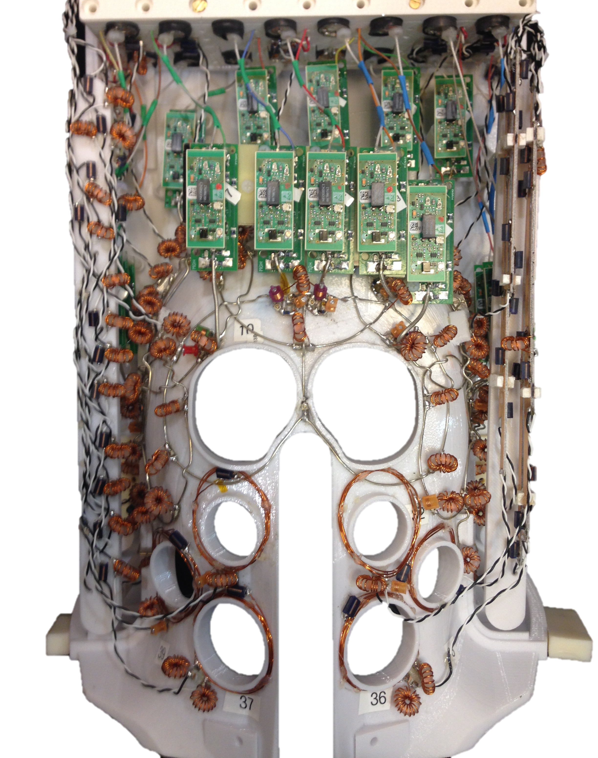
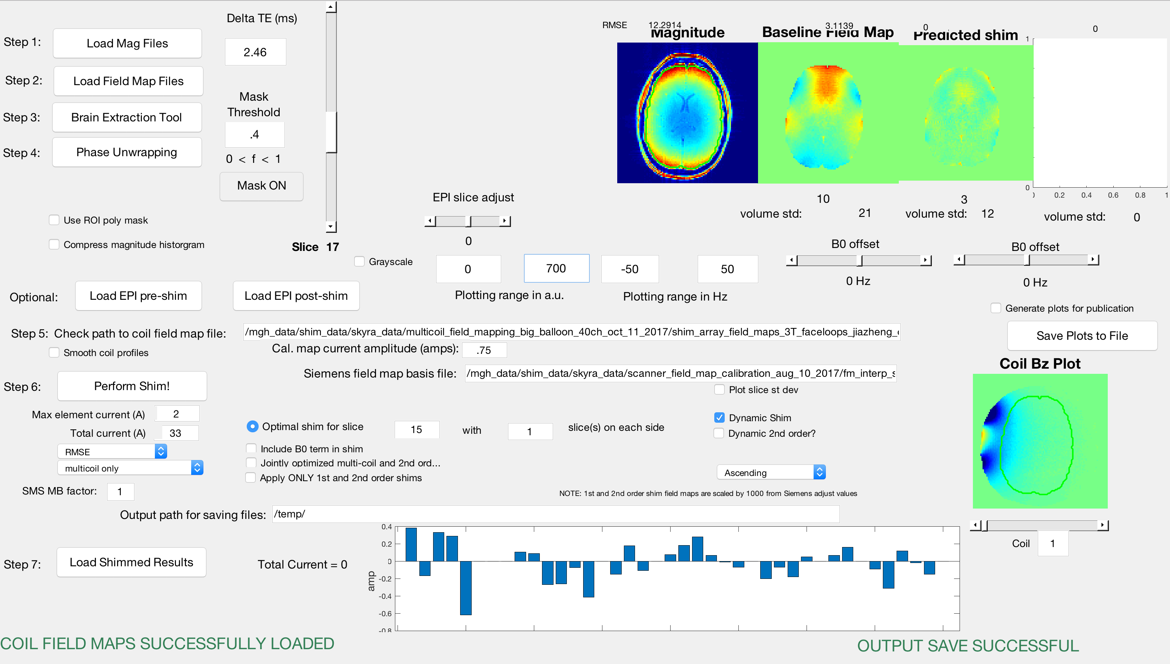
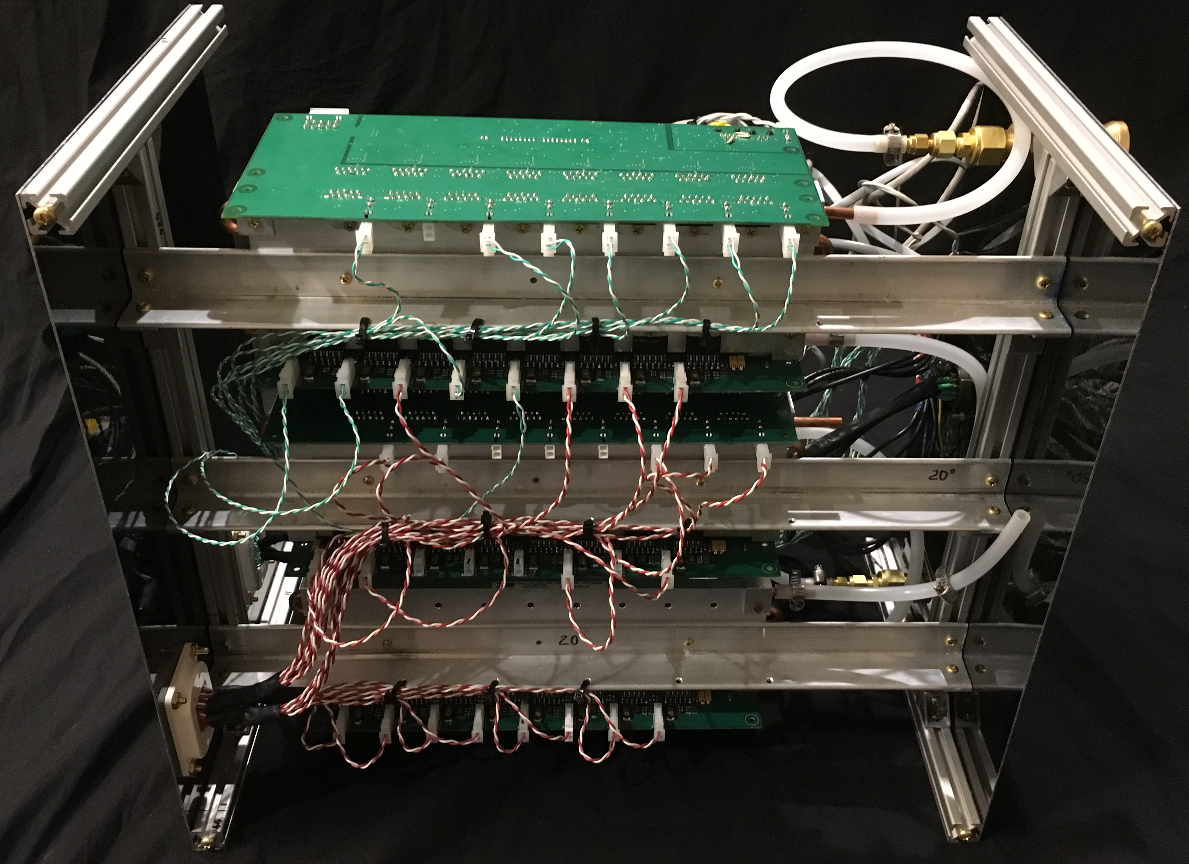
Console room
Magnet room
Equipment room
ΔB₀/Rx array coil in magnet bore
Faraday cage
Cabling for 31 shim channels
USB port
Arduino microcontroller
TTL trigger from scanner
Shim amplifiers
Switch-mode Power supply (12V, 80A)
Filter
SPI Bus
SPI Bus
Fiber optic transmitter/receiver
Fiber optic transmitter/receiver
Optional pump for water cooling
Fiber cable
Tygon tubing
RF waveguide
Figure. Experimental setup of dynamic B₀ shimming hardware. ΔB₀ field maps are processed off-line on a laptop computer and optimal shim currents for each slice are computed. The shim settings are sent to an Arduino microcontroller which then sends SPI bus commands to the digital-to-analog converters on the amplifier boards via fiber optic cable. The amplifiers are placed inside the magnet room to minimize the number of feedthrough filters required. Only the 12V power rail and ground for the amplifiers required filtering. The amplifier outputs are supplied via twisted pair cables to the ΔB₀/Rx array coil inside the magnet bore. For slice-optimized, dynamic shimming, TTL pulses supplied by the scanner trigger the microcontroller to update the shim currents 500us before the beginning of each TR. Amplifier output currents are monitored and sent back to the microcontroller via an analog-to-digital converter.

Slide 8
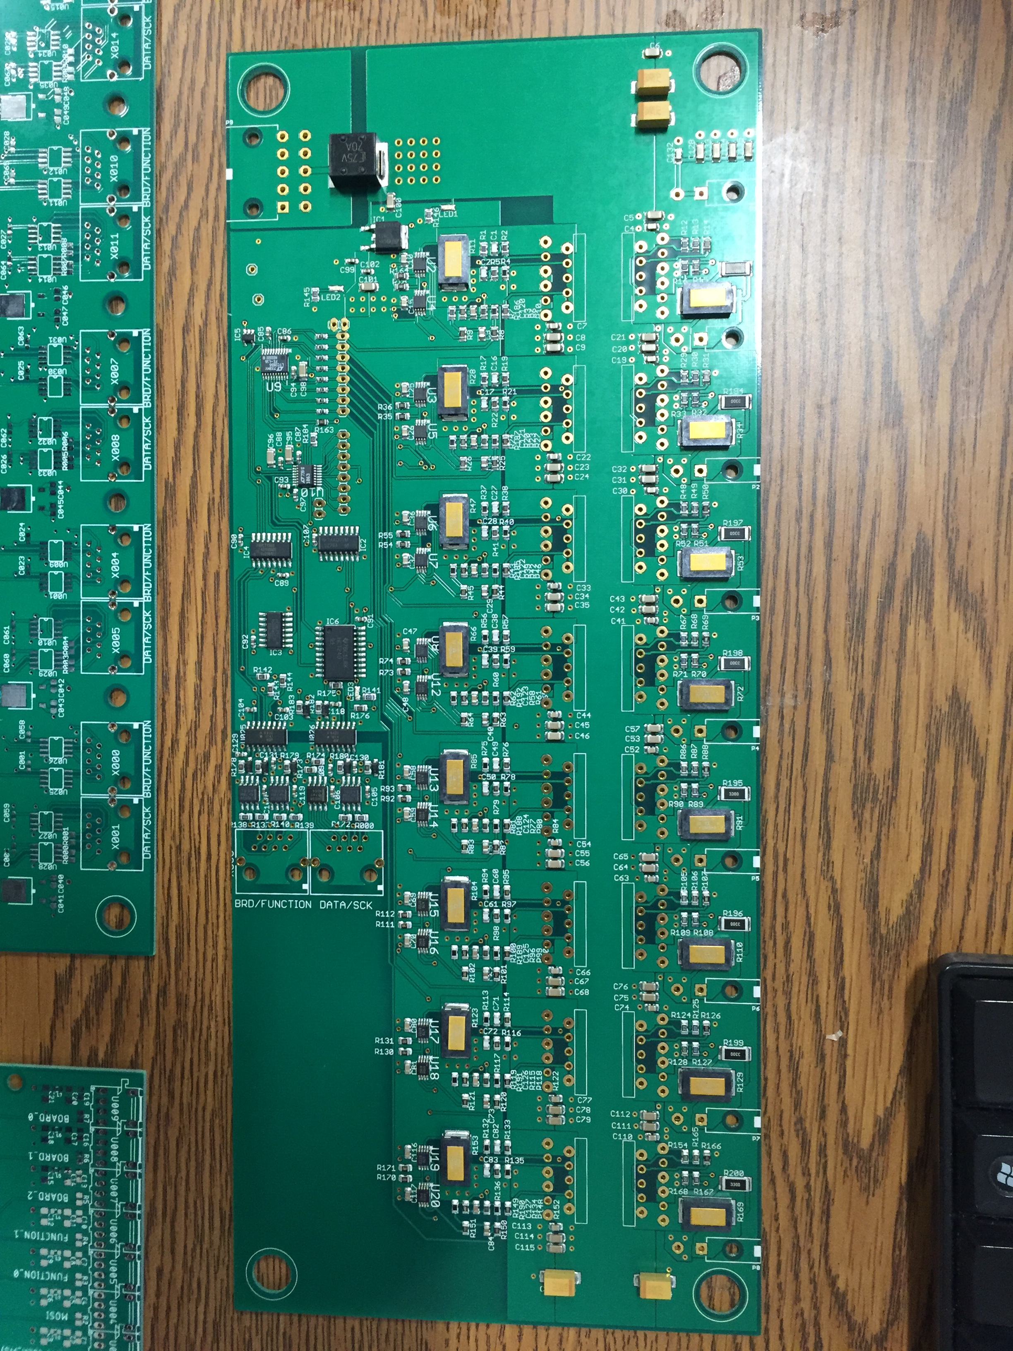
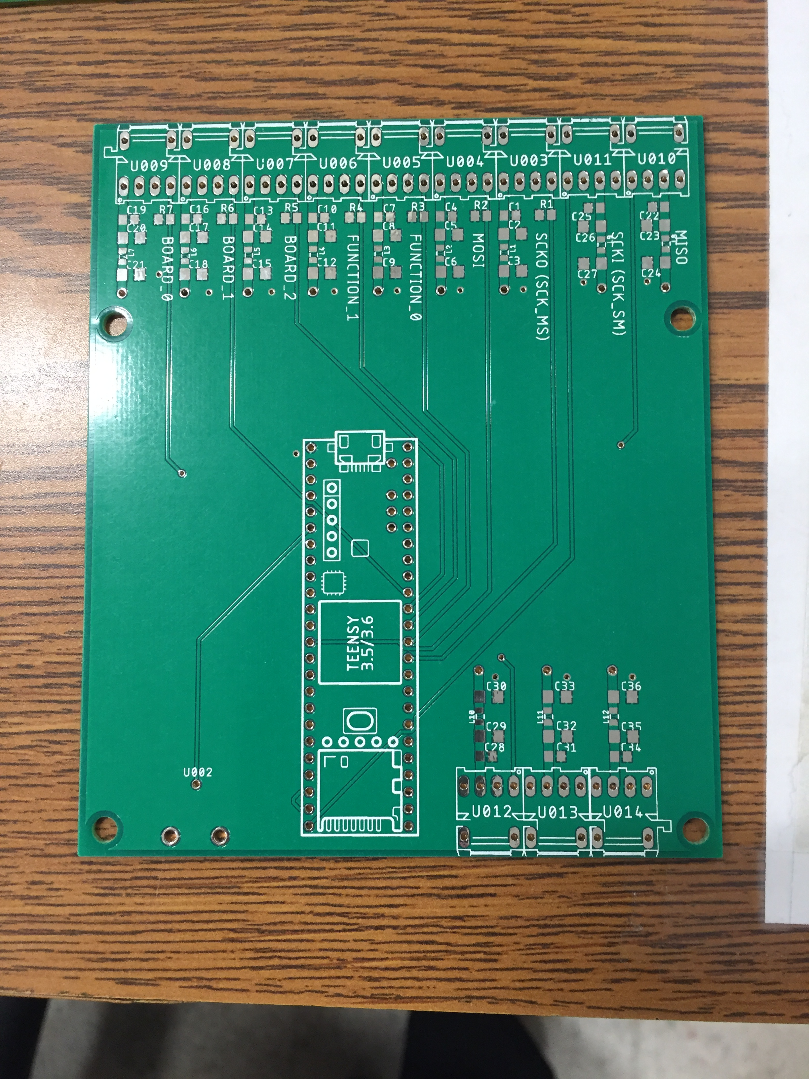
Large order of populated amplifier boards received in Oct. 2018. Only through-hole components remain to be added (power amplifiers and connectors).
8ch amplifier board
Arduino microcontroller daughter board
Completed amplifier board with heat sink
8ch fiber optic interface board

Slide 9
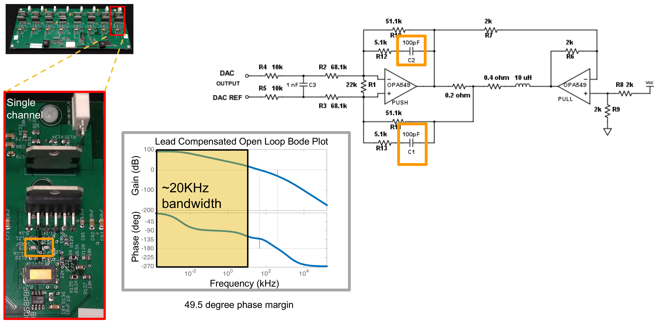
Design: Linear, current feedback, lead-compensated push-pull
Provides ~30μs rise time for driving 10μH shim coil load

Slide 10
Enclosure/chassis photos

Slide 11
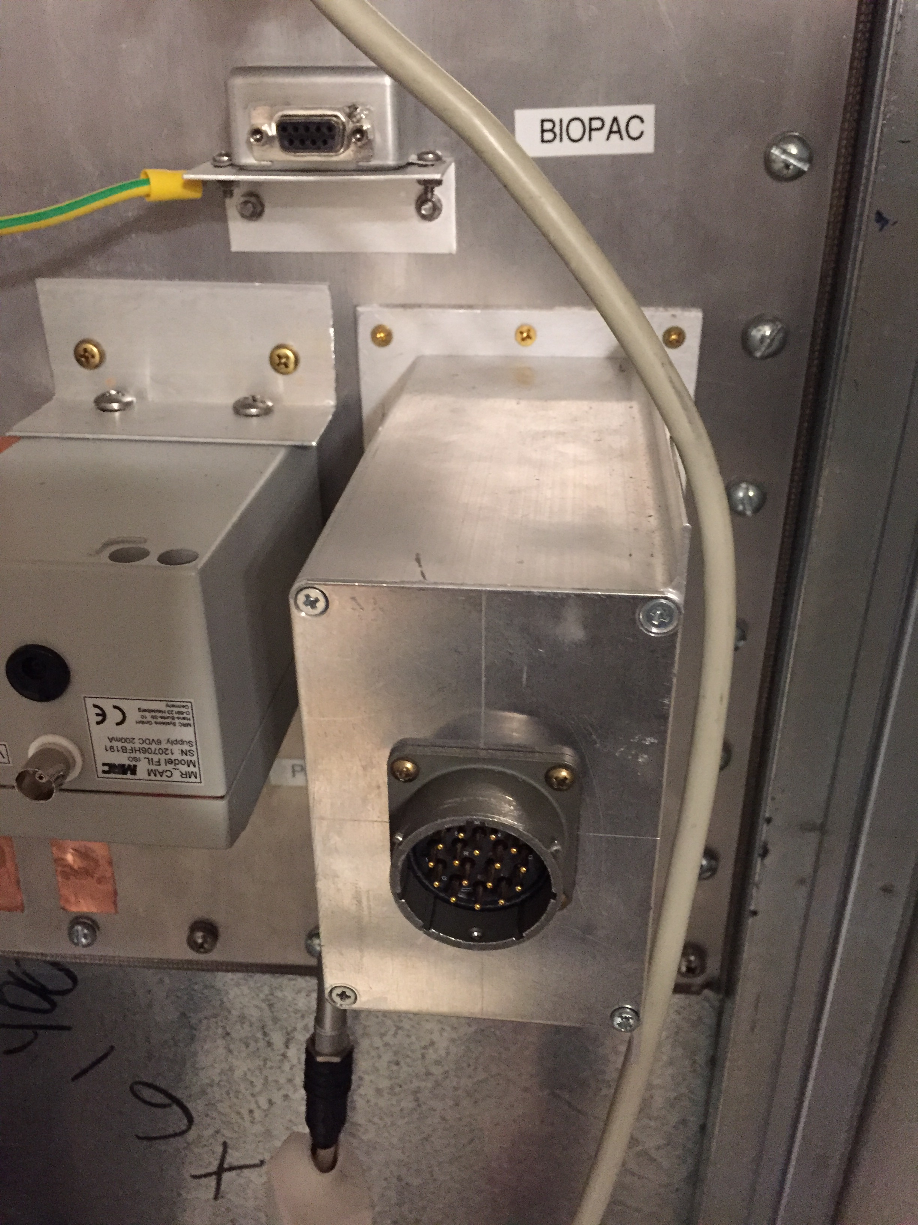
Filter box on scanner filter panel

Slide 12
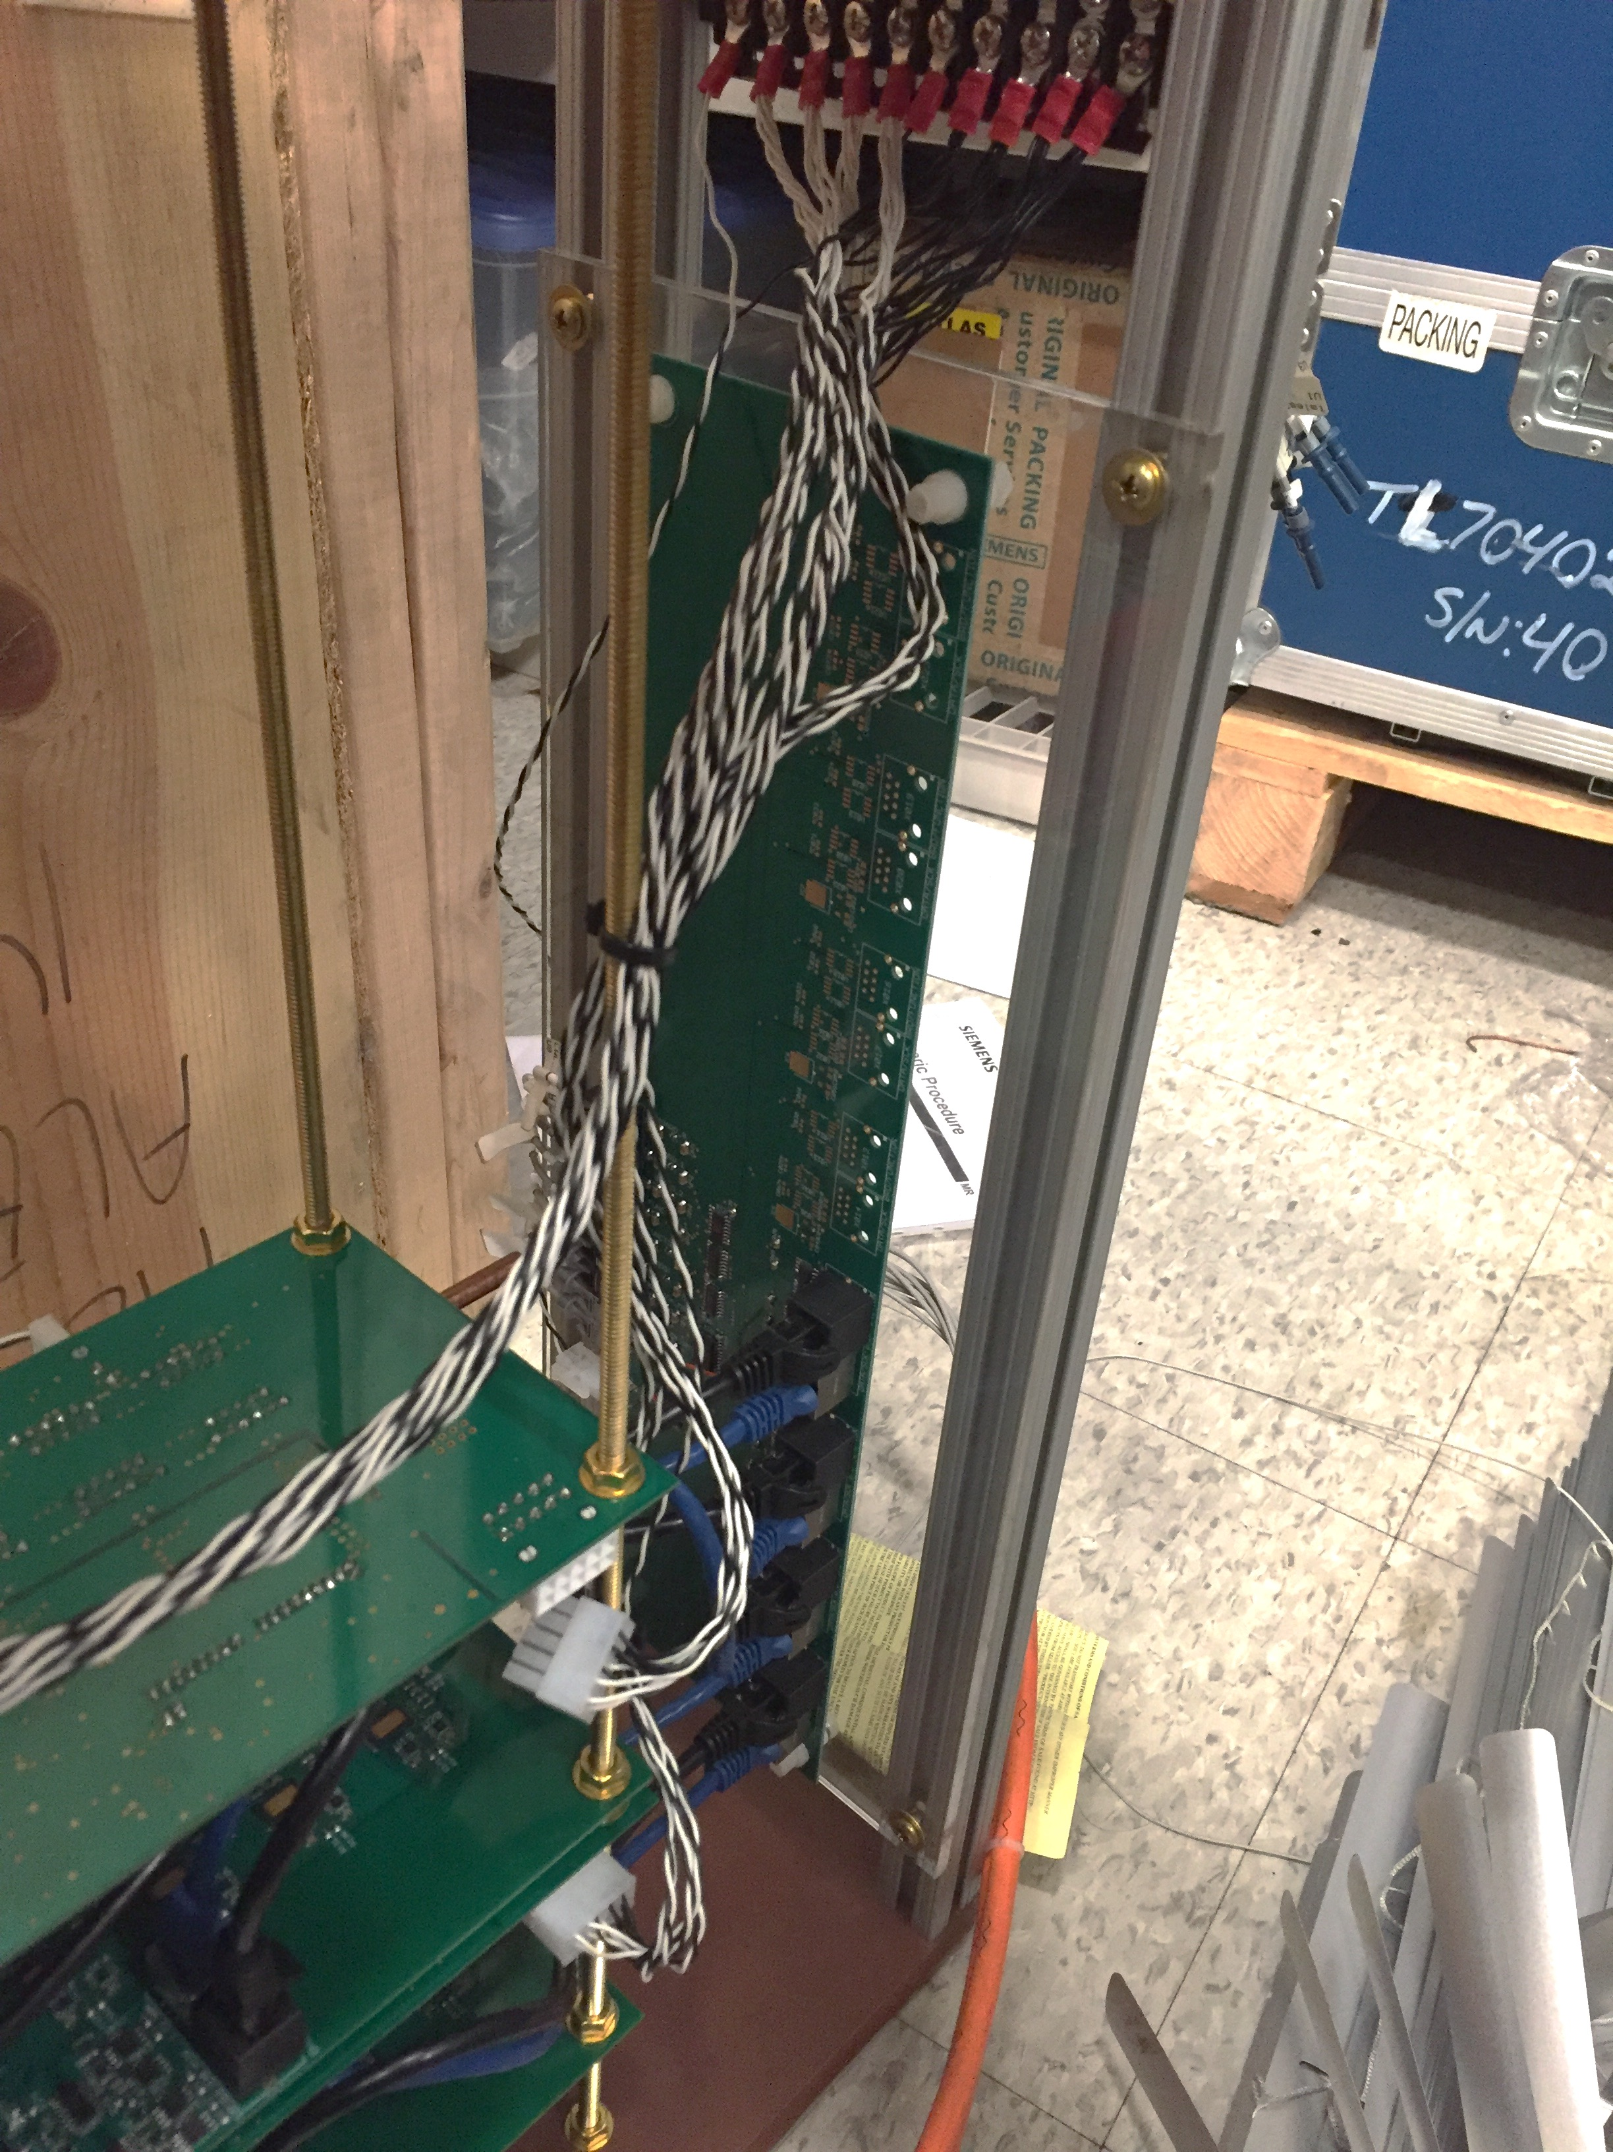
Amplifier chassis photos
Fiber board is mounted vertically to allow short ethernet cable runs to the amplifier boards, which are horizontal

Slide 13
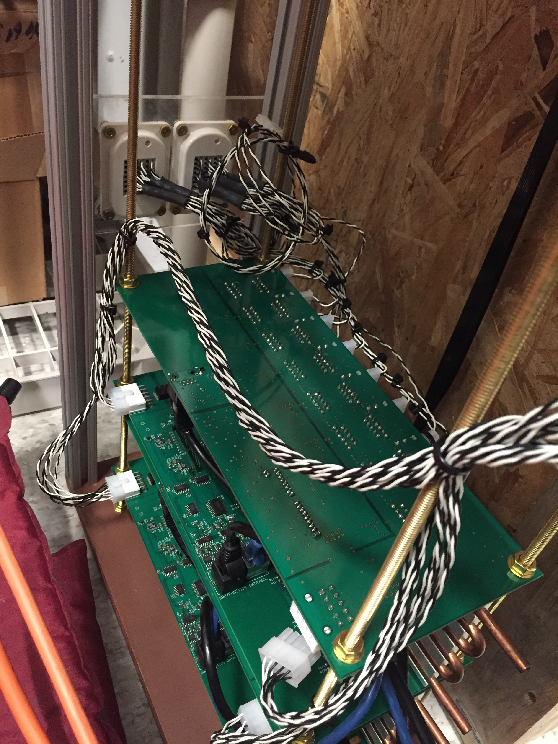
Use brass rods to support boards on heat sinks
Use non-magnetic fasteners!

Slide 14
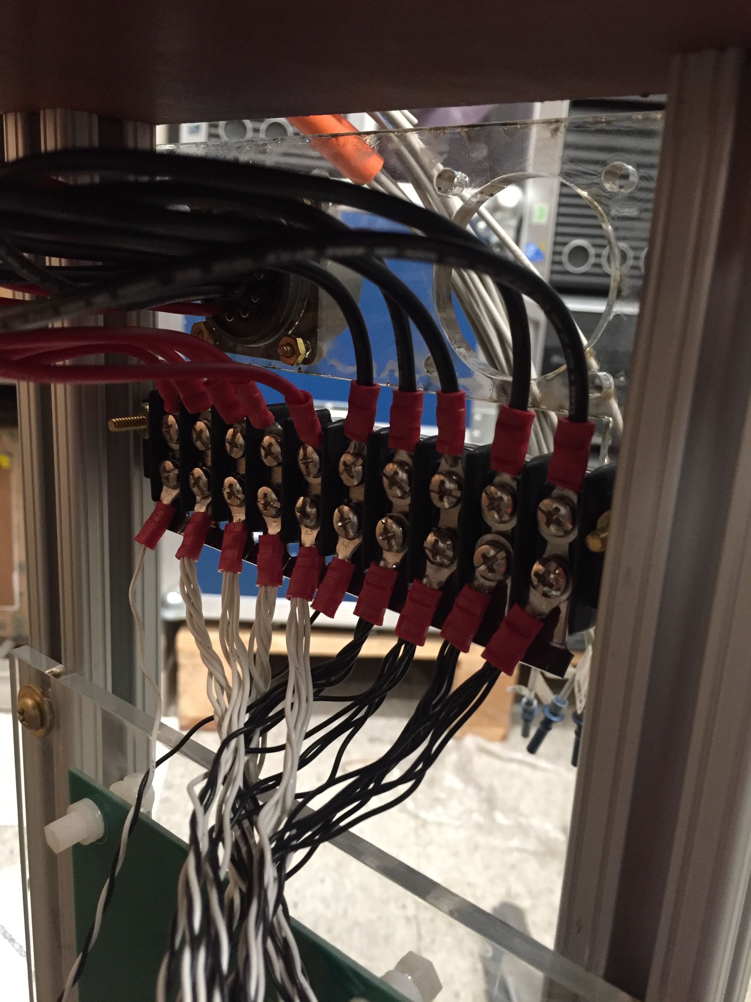

Slide 15
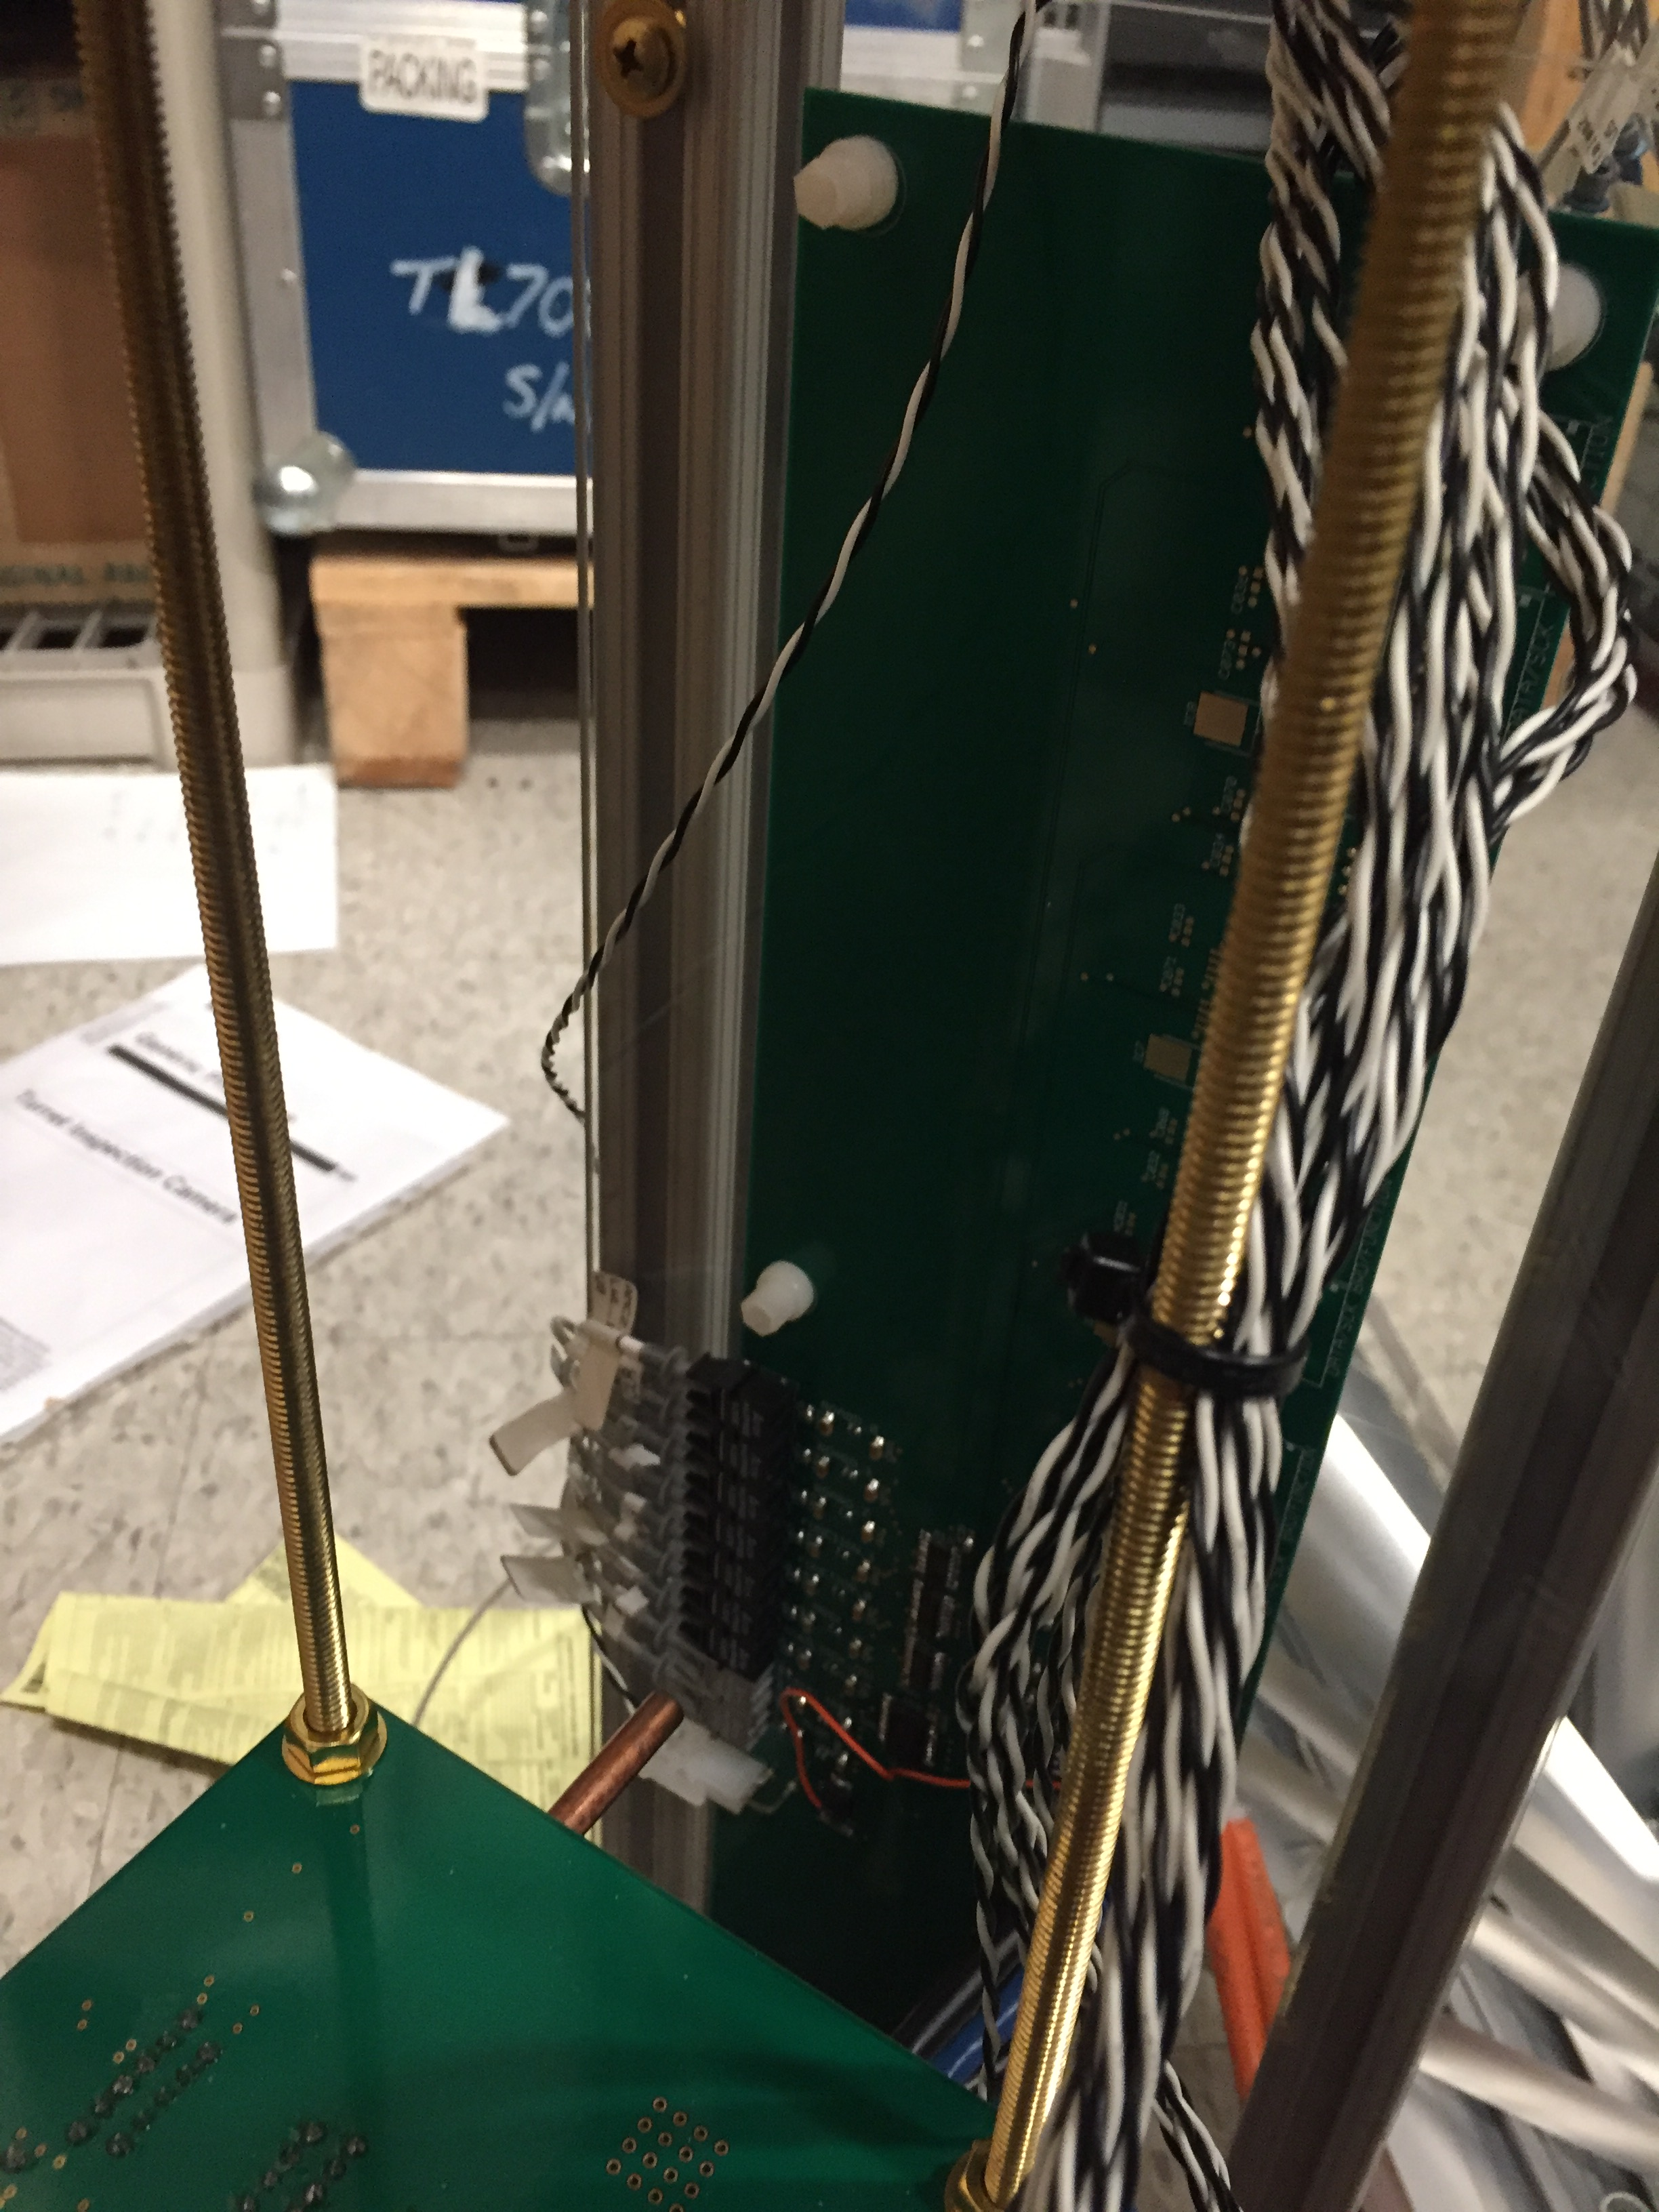
Fiber optic connections
Make sure to add some sort of strain relief for the fiber optic cables

Slide 16
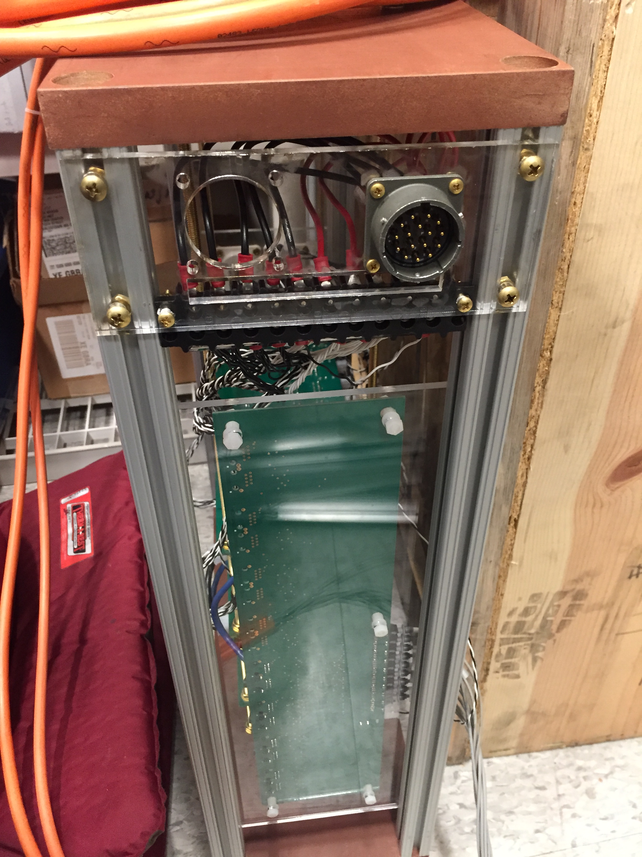
+12V Power connection

Slide 17
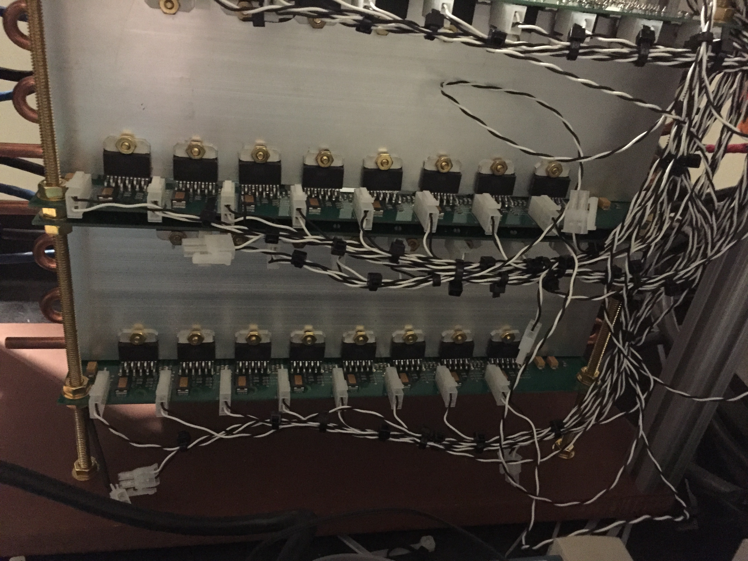
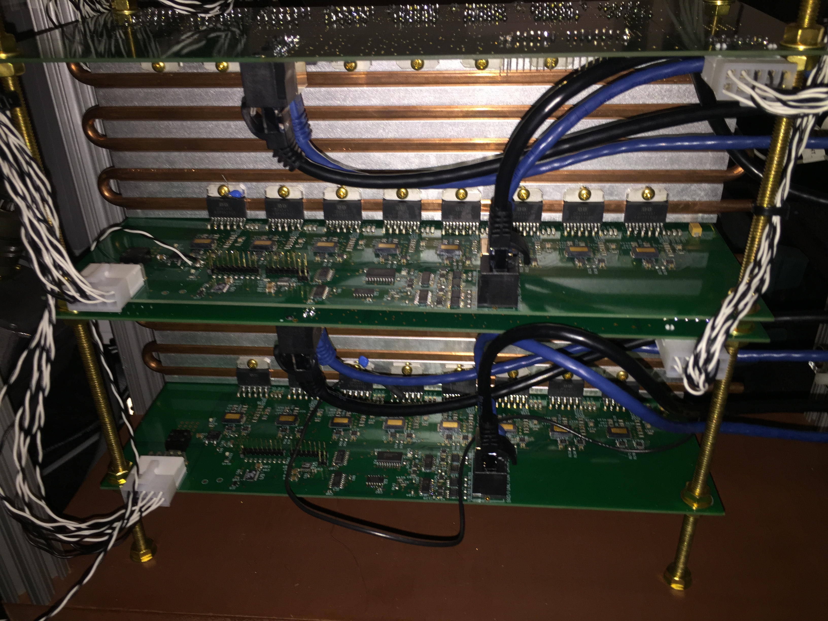
Steps for installing OPA-549 to avoid mechanical stress on solder joints:
Drill holes in heat sink
Set up PCB on brass threaded rod with nuts to hold it in place. Remember to use thermal compound between op amp and heat sink
Temporarily attach OPA-549 pair to heat sink with screw
Solder pins to PCB
Do not solder the op amps first, and then install the bolts second. This can damage the pins.

Slide 18
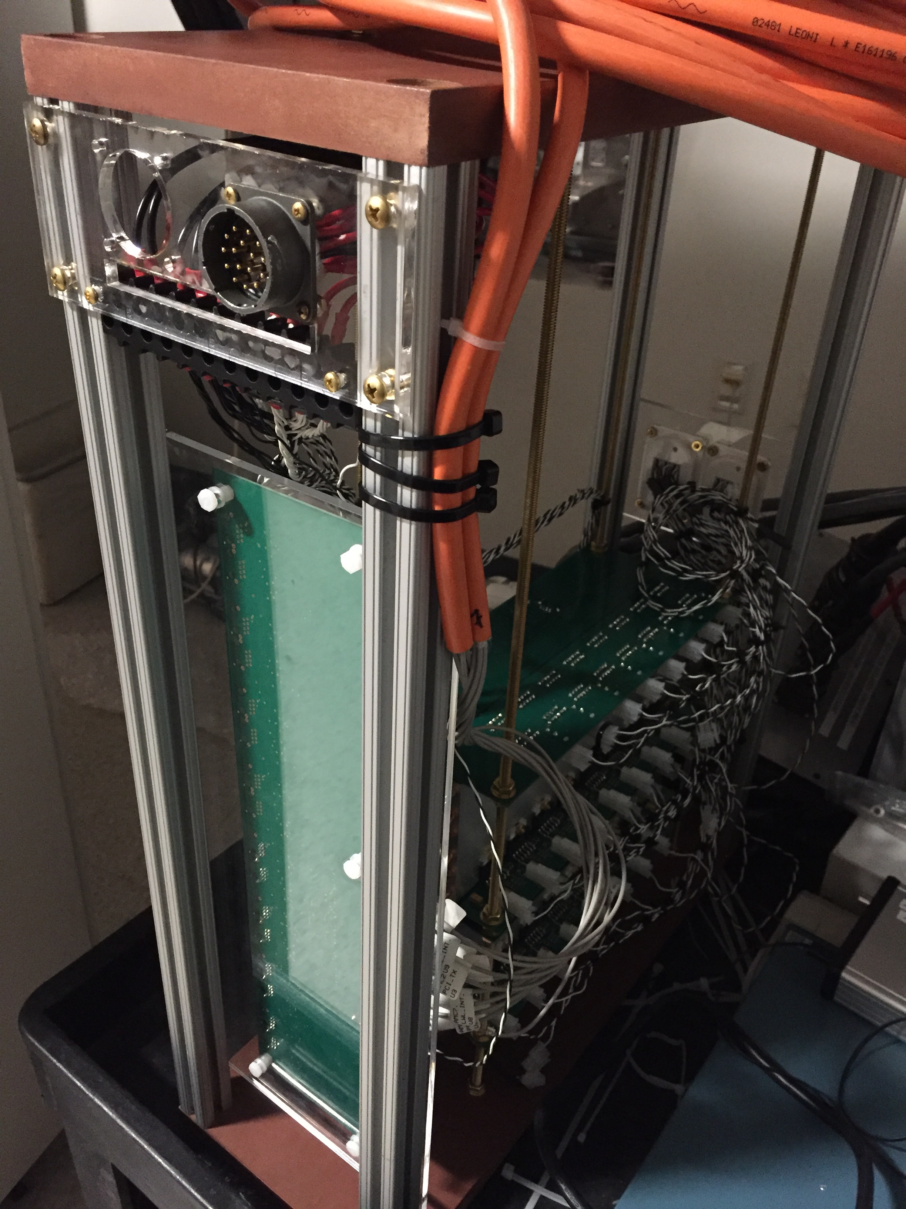
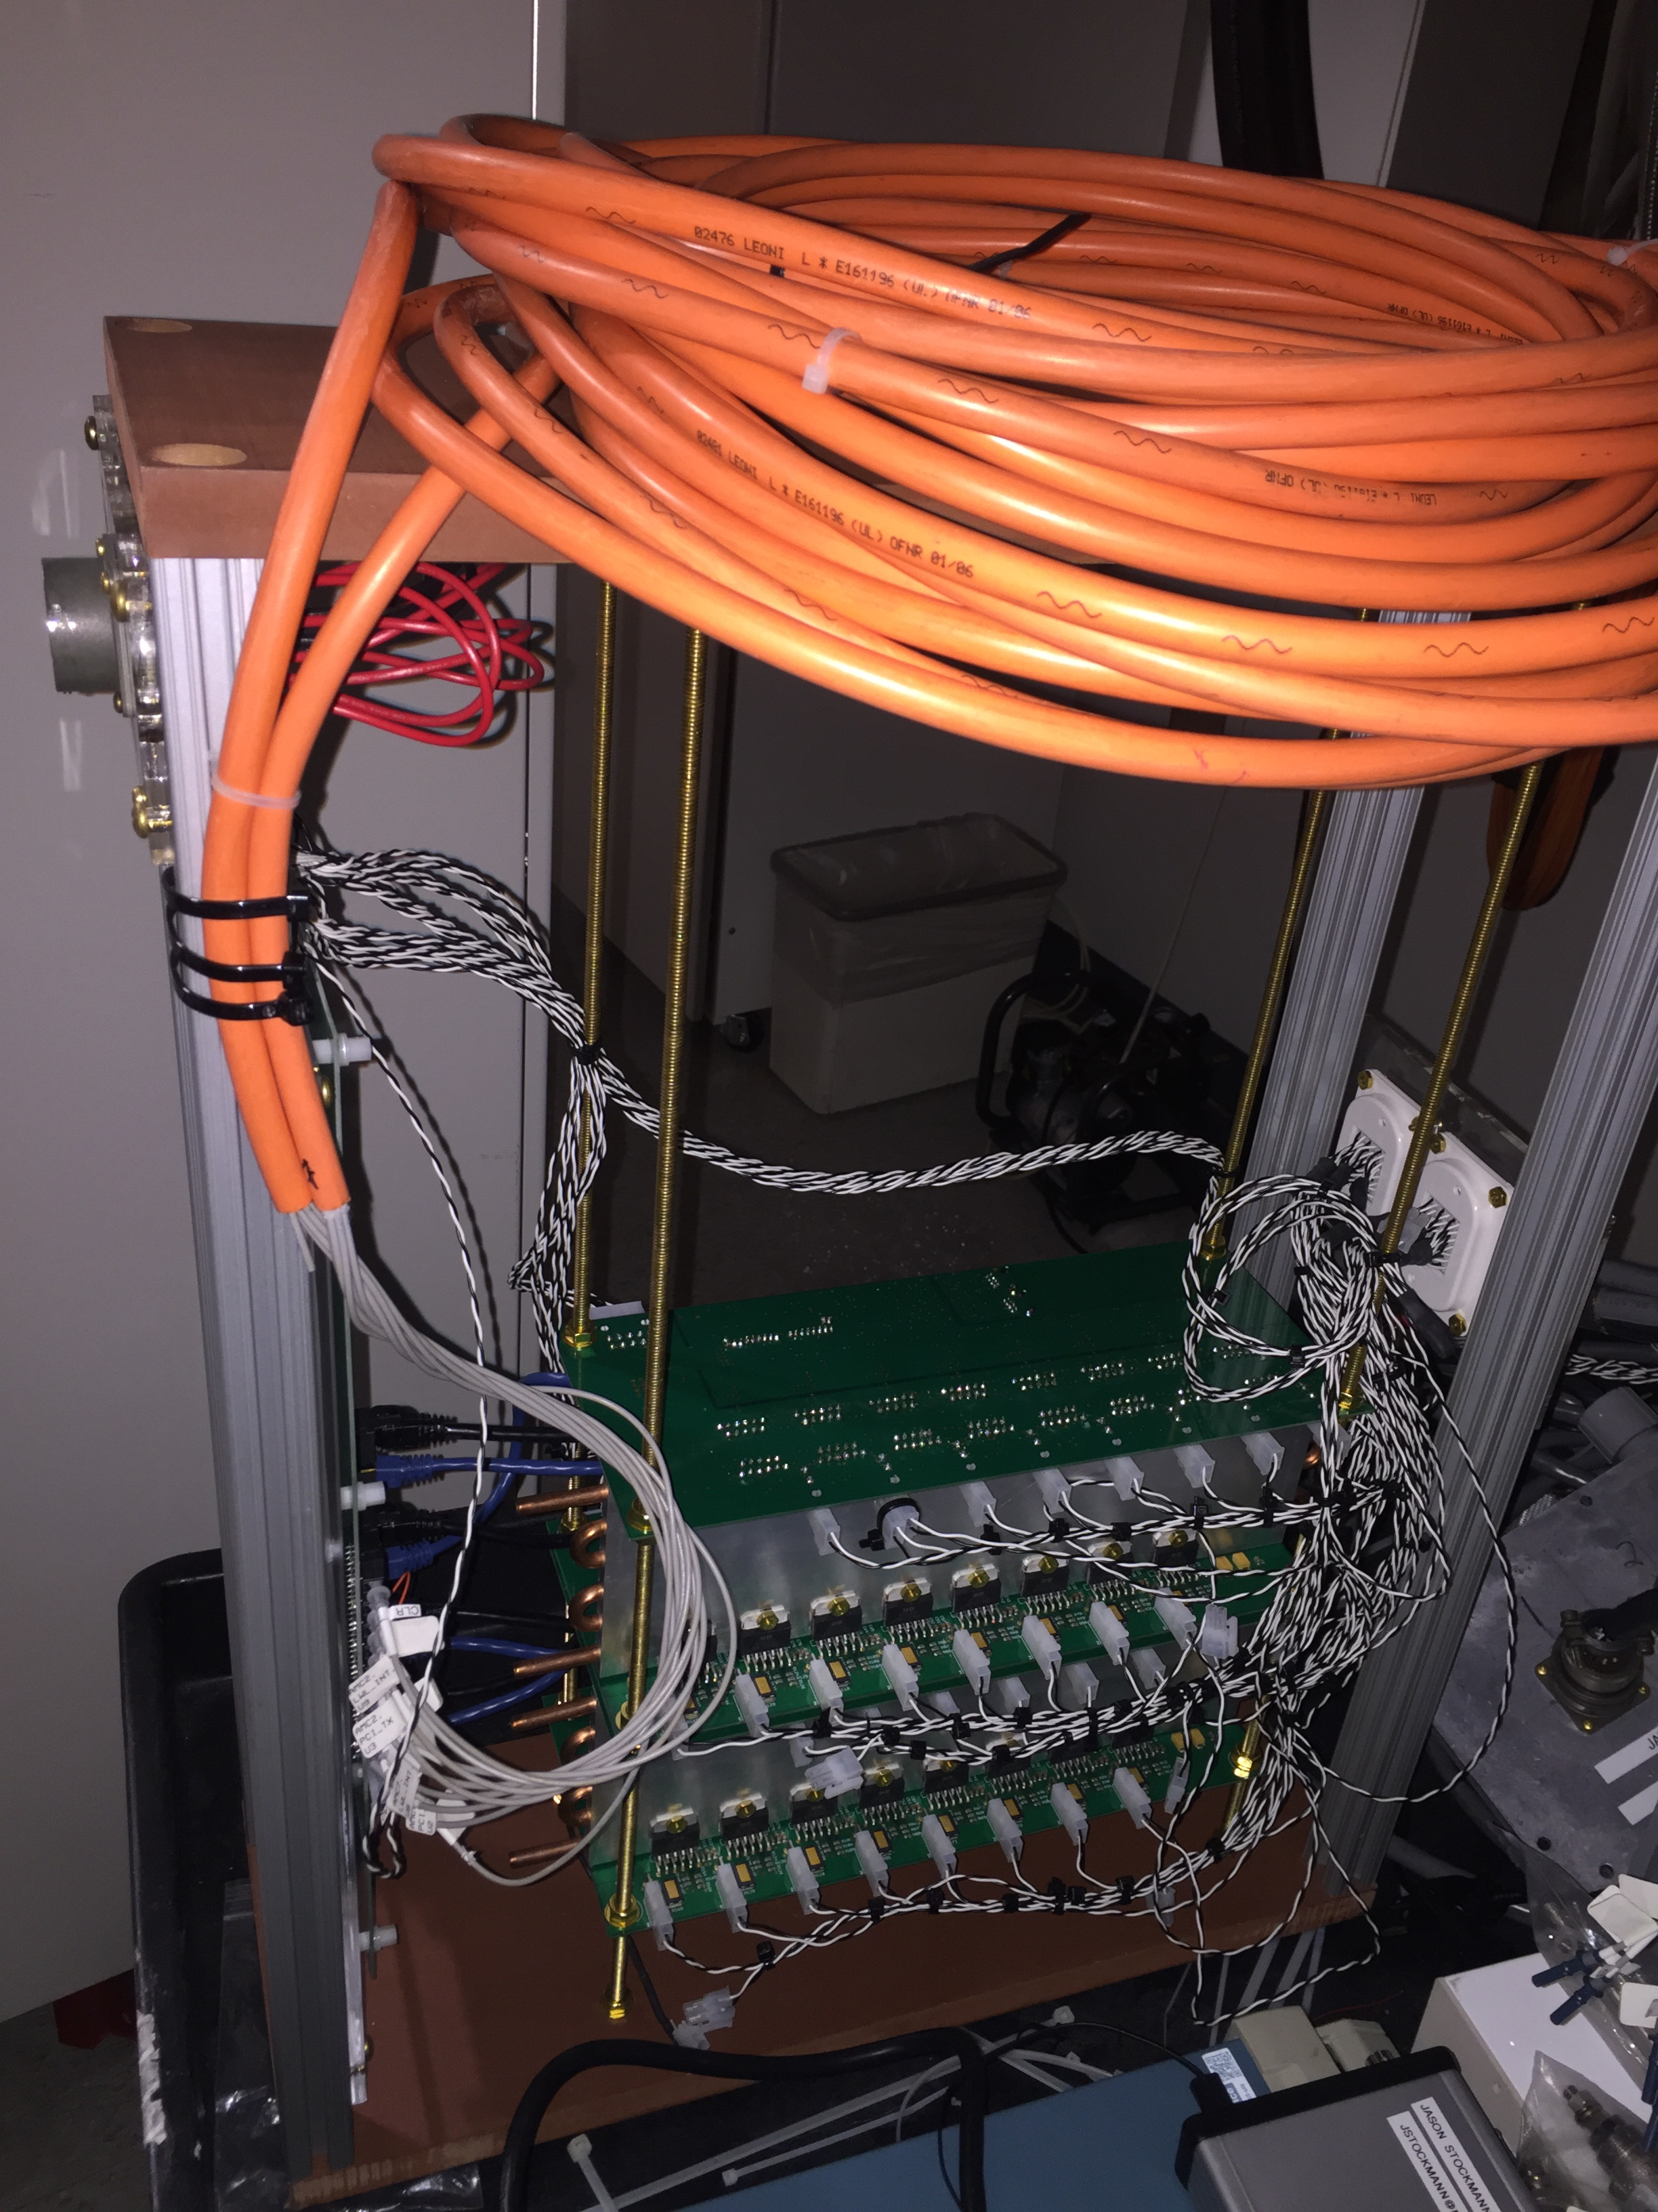

Slide 19
Power supply enclosure

Slide 20
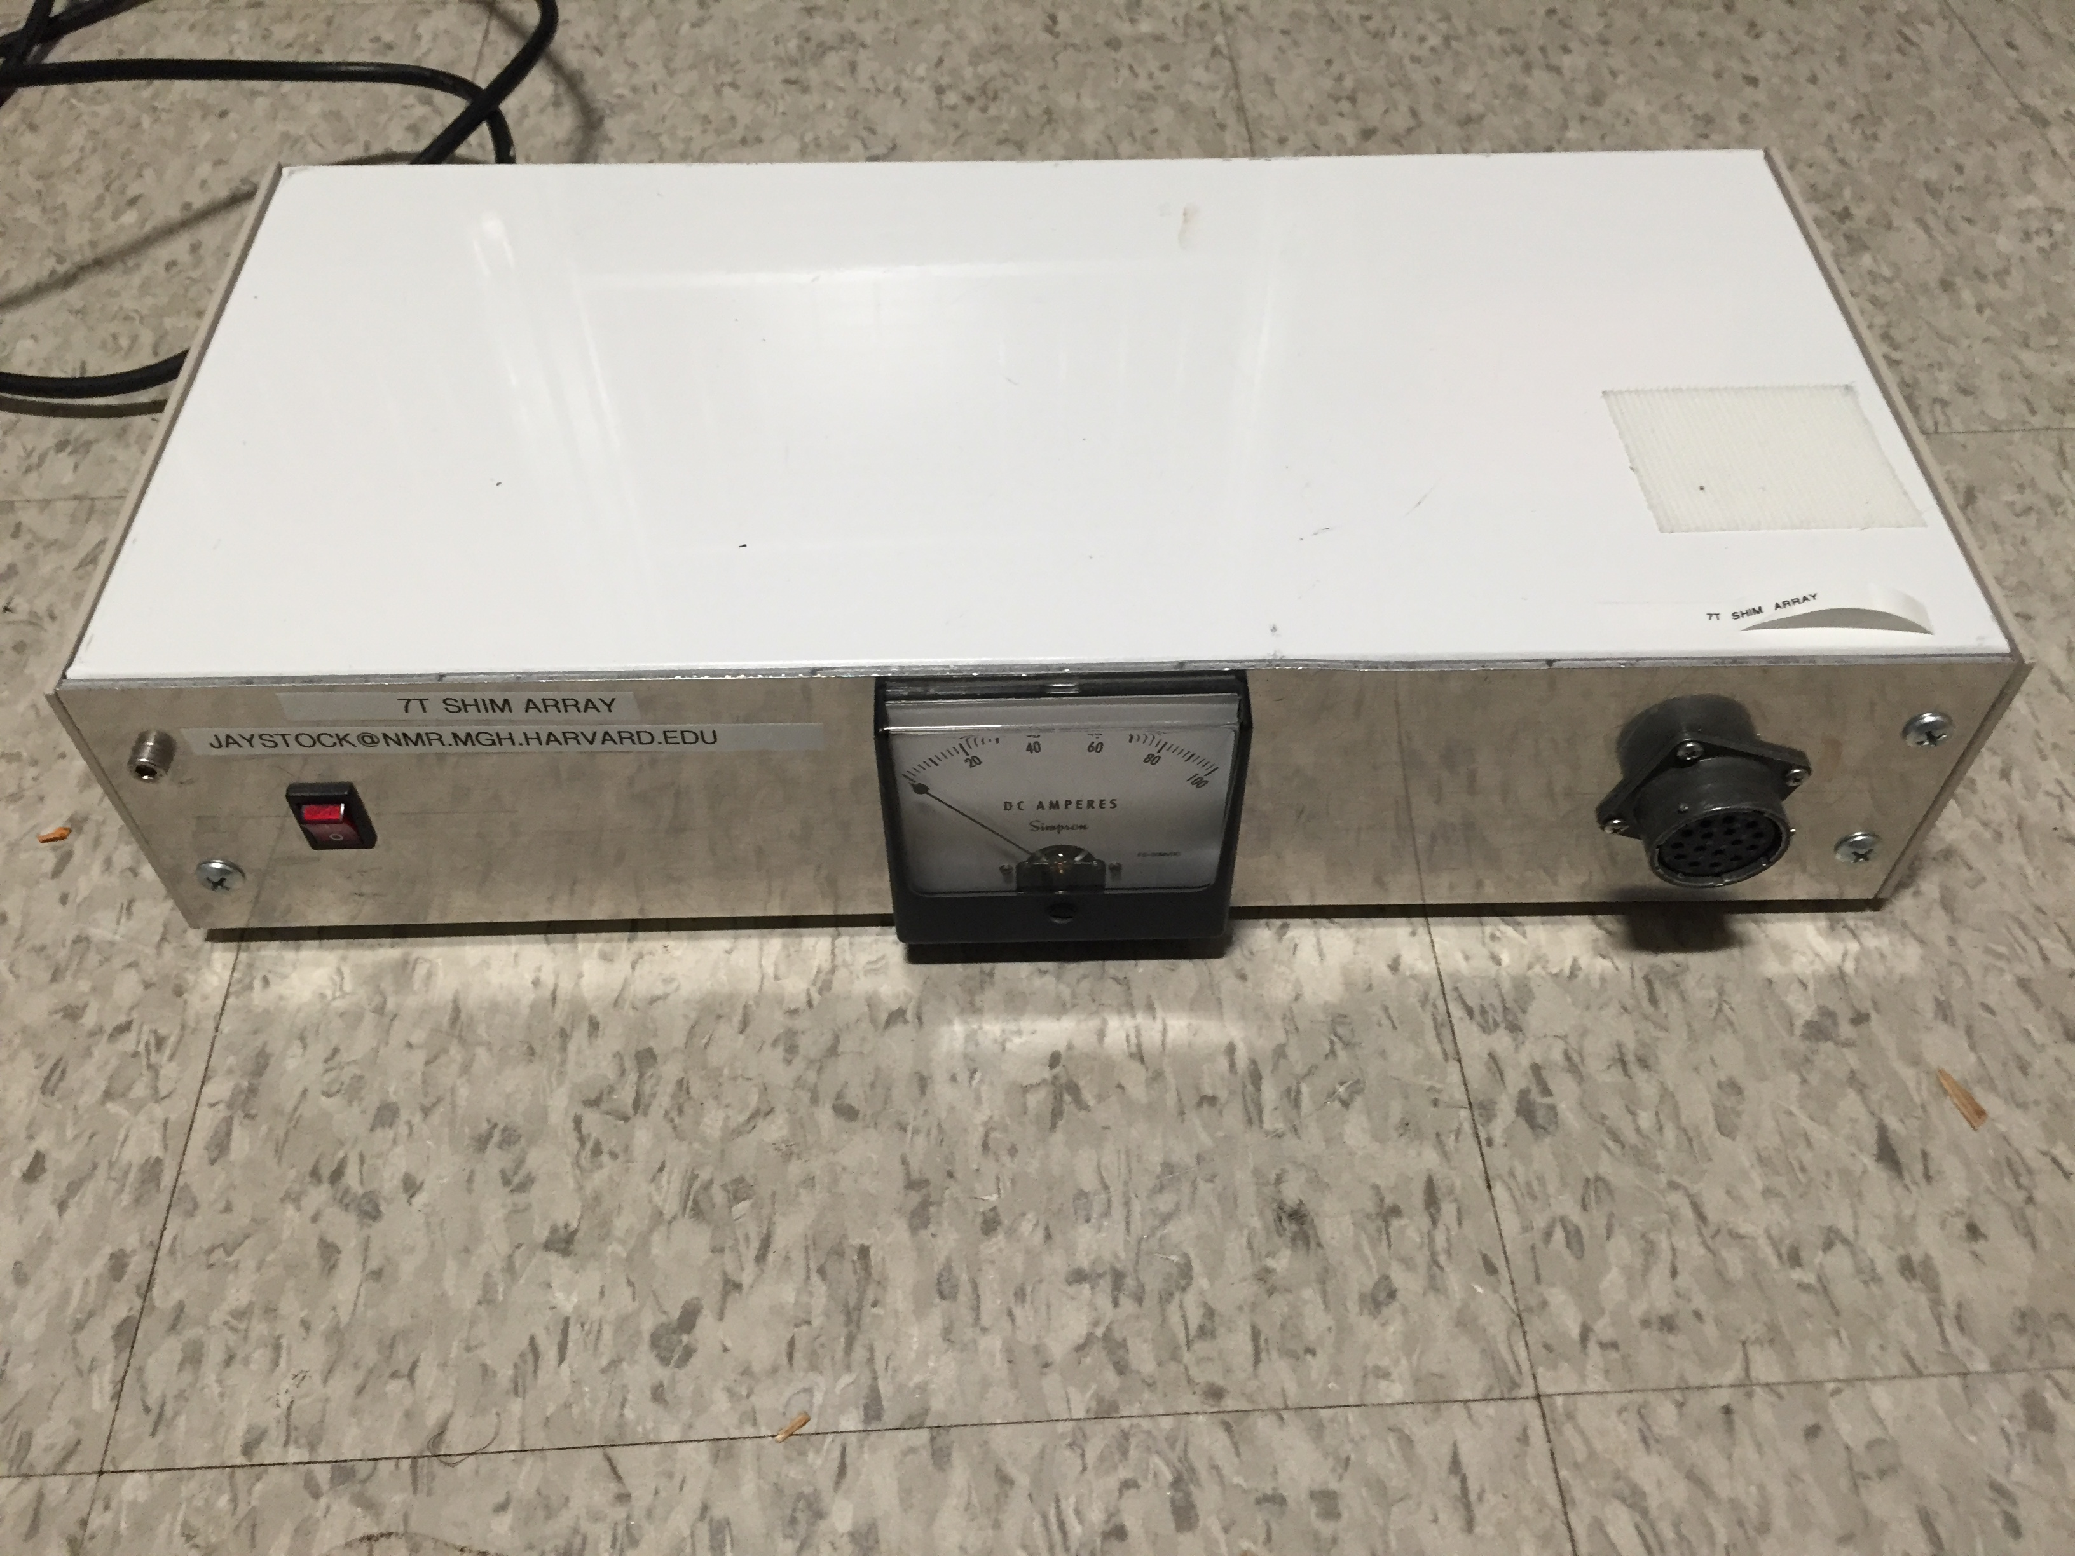
12V, 100A power supply enclosure with ammeter

Slide 21
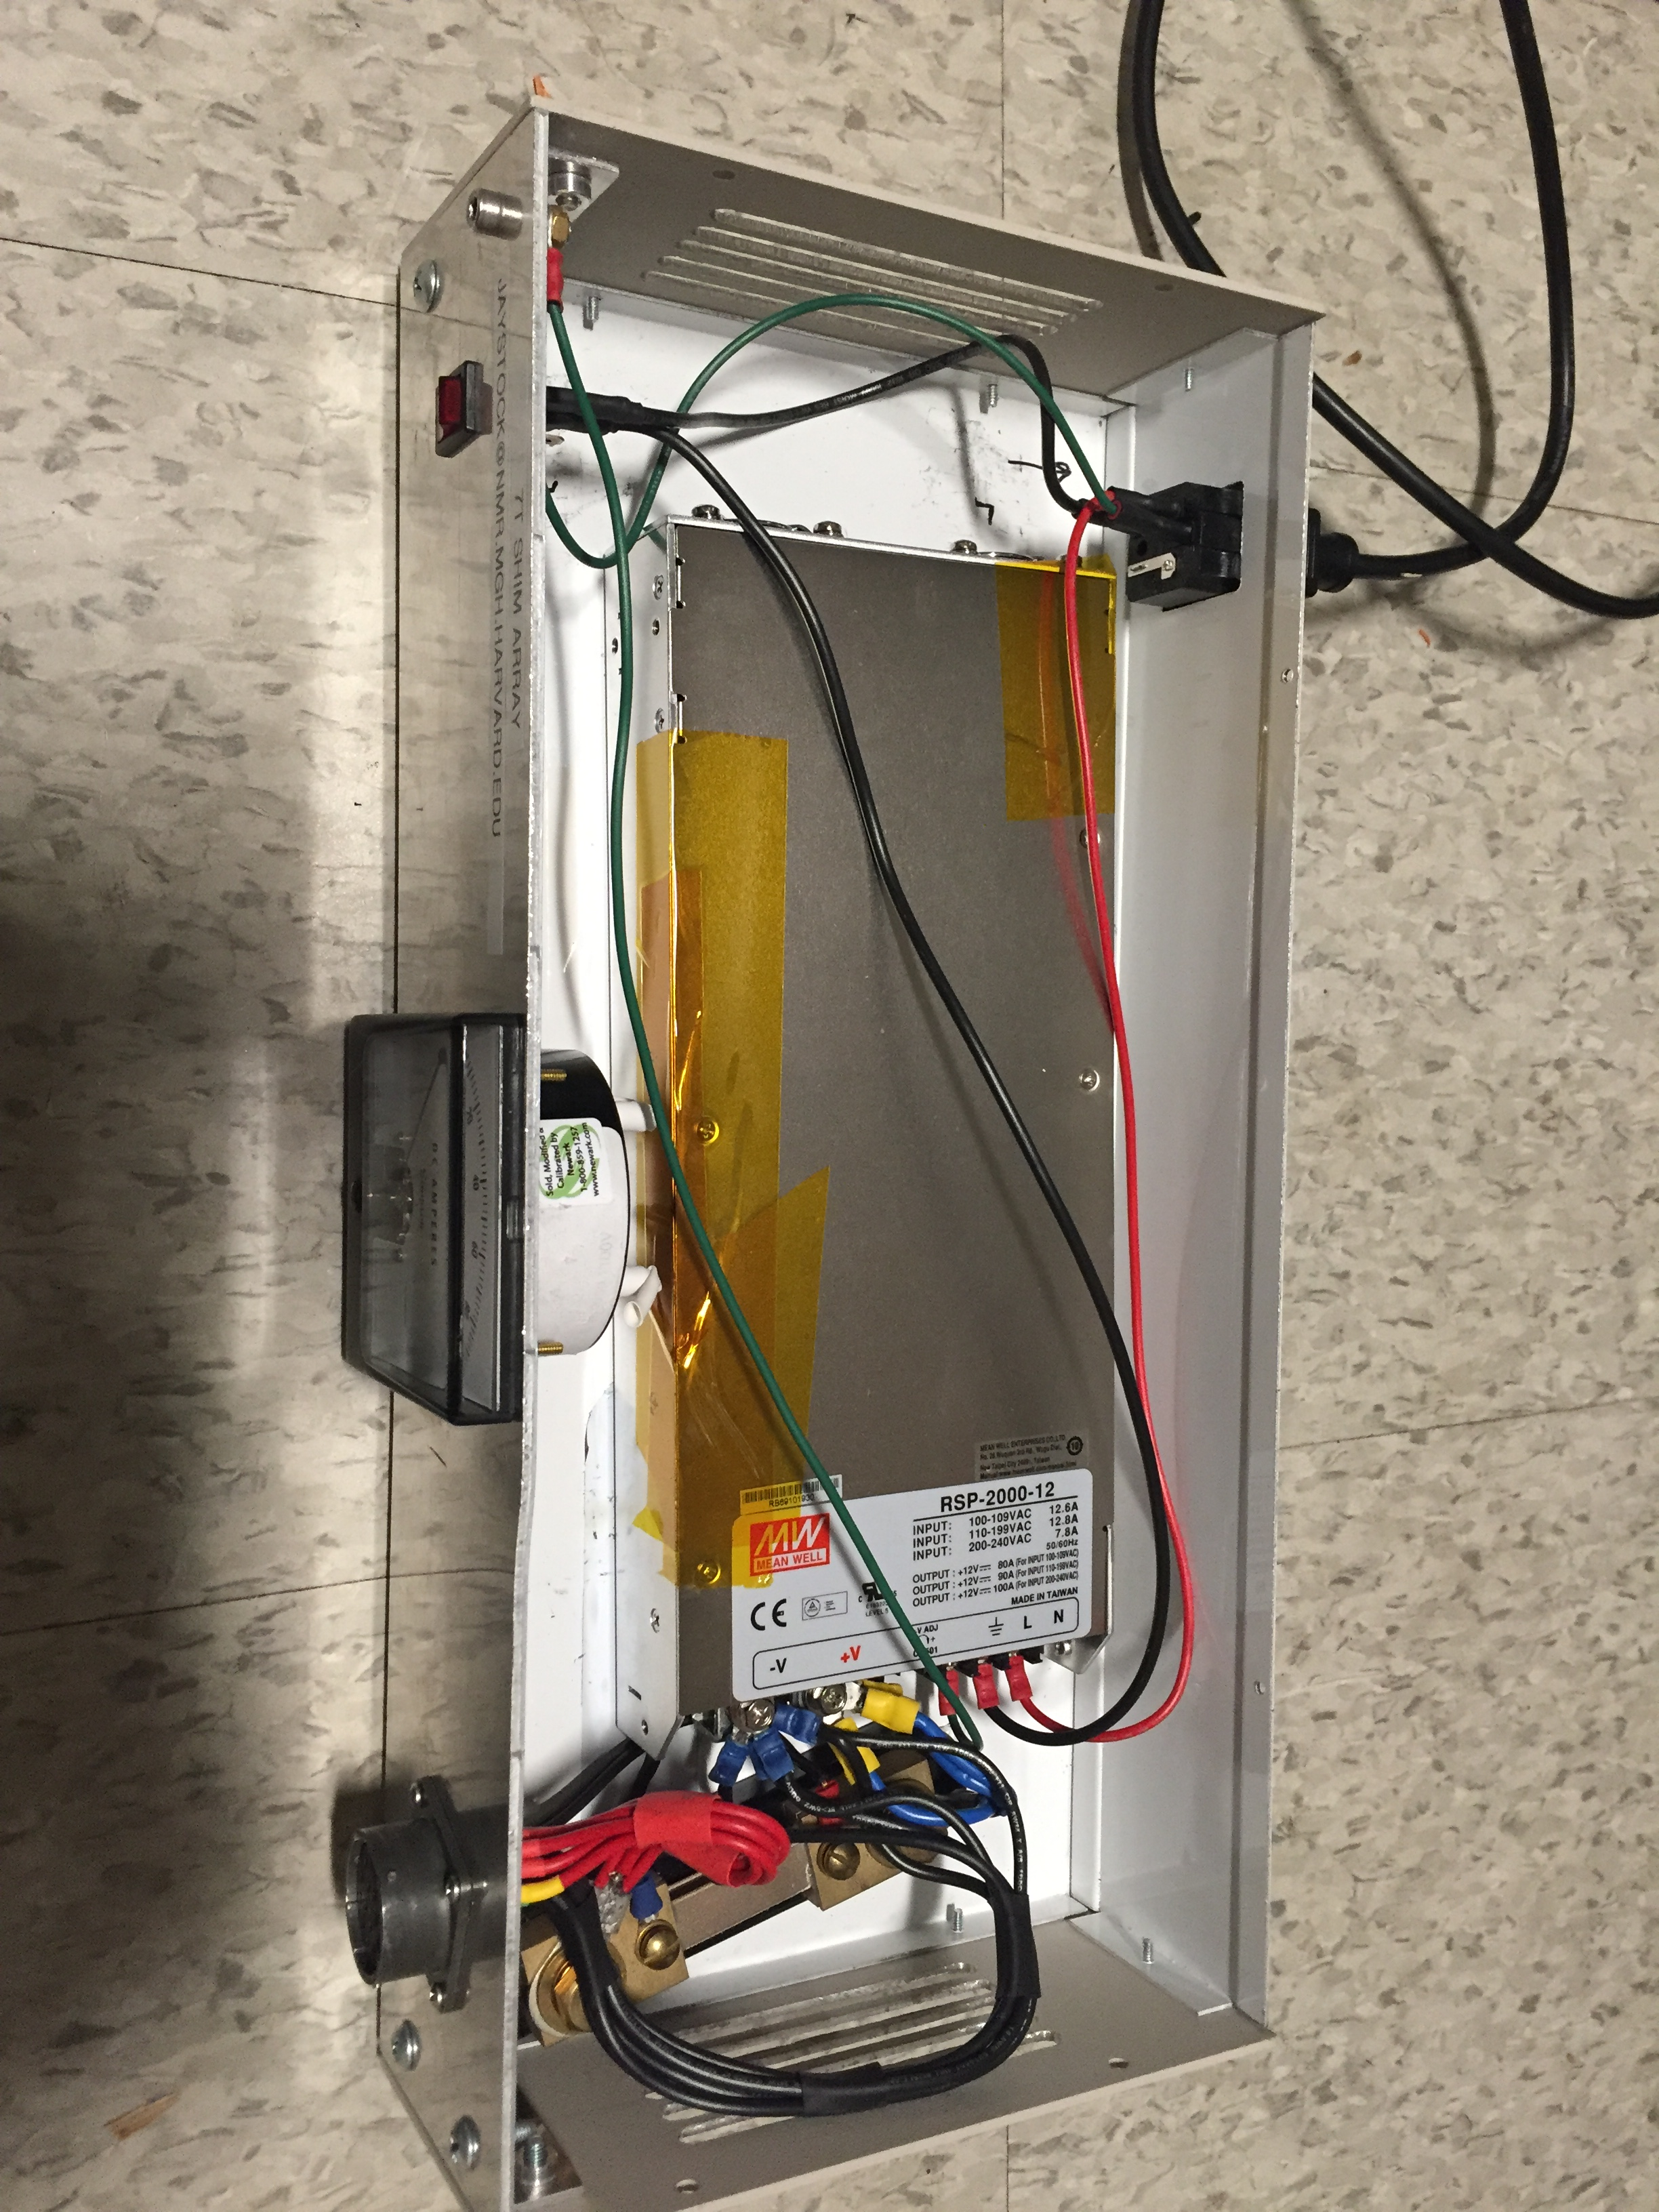
Outlet includes fuse
Inside of power supply
Make sure to use fuse on the AC input for safety!!!

Slide 22
Cabling considerations

Slide 23
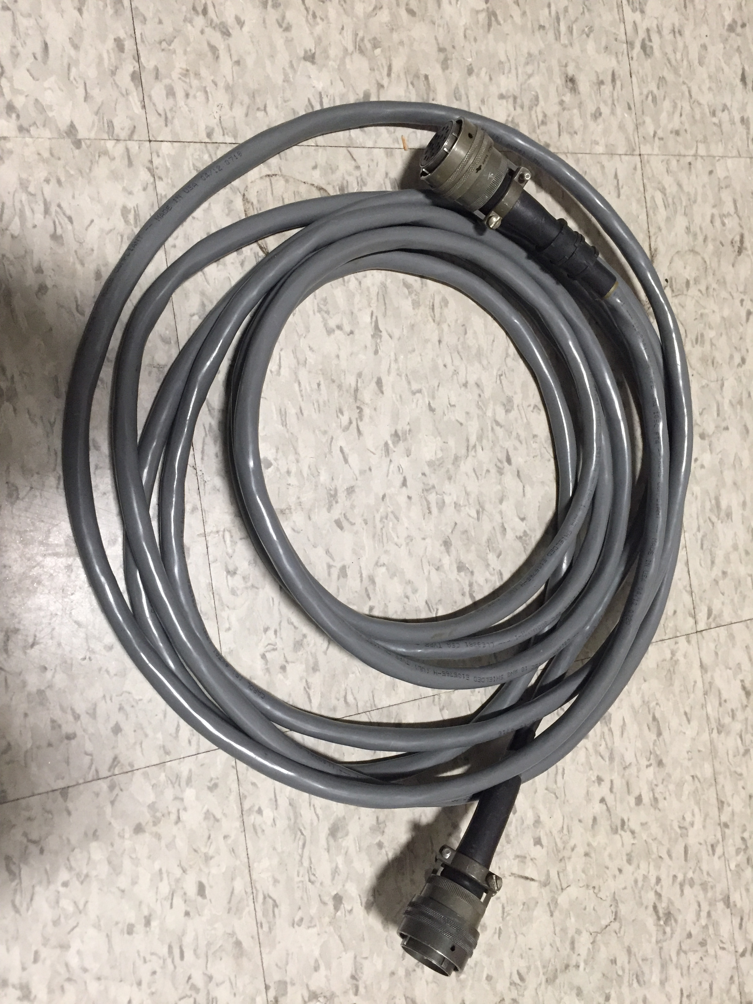
MIL-SPEC Amphenol 16-pin connector for supplying 12V power to shim amplifiers (through filter panel). Note that these connectors have a ferrous washer to make the bayonet connection mechanism work. Minor issue inside the scanner room.
Suggested pinout:
Pins A-E: +12V
Pins M, S, R, P, N: Ground/return path
Pins L, K, J, H, G, F: Reserve/unused

Slide 24
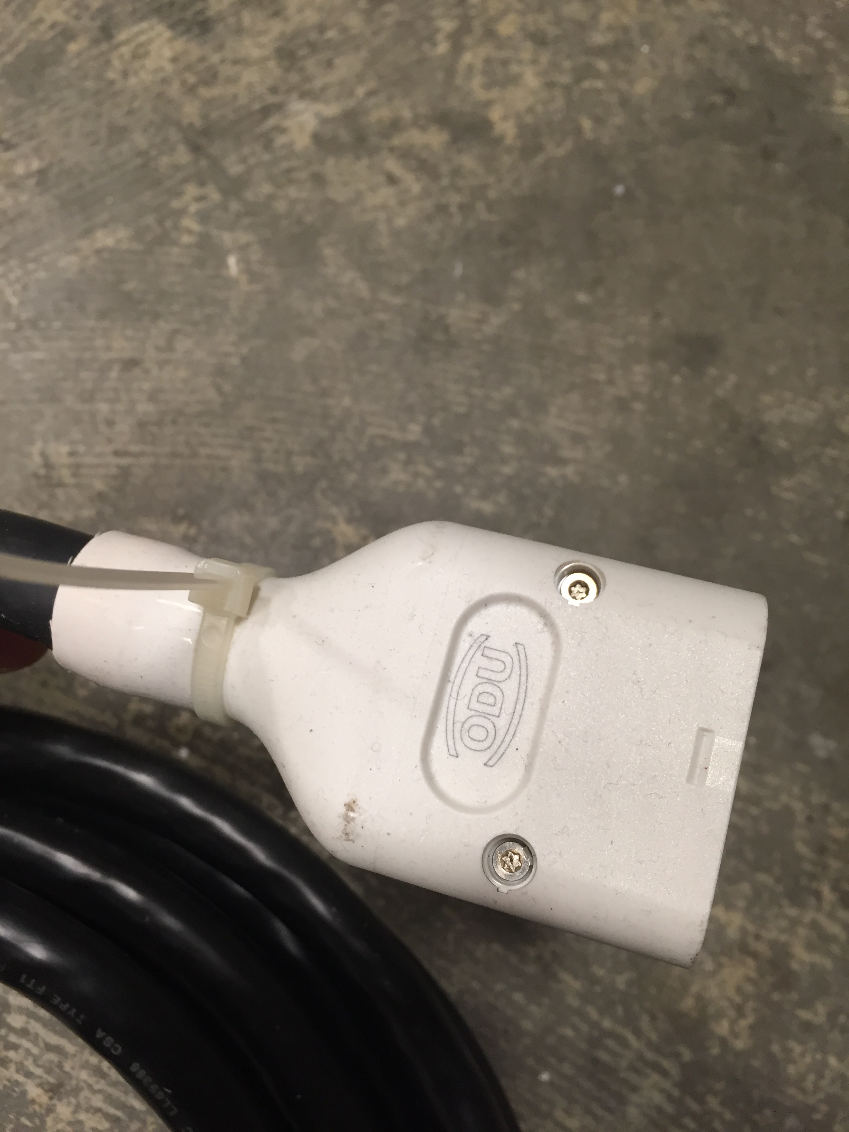
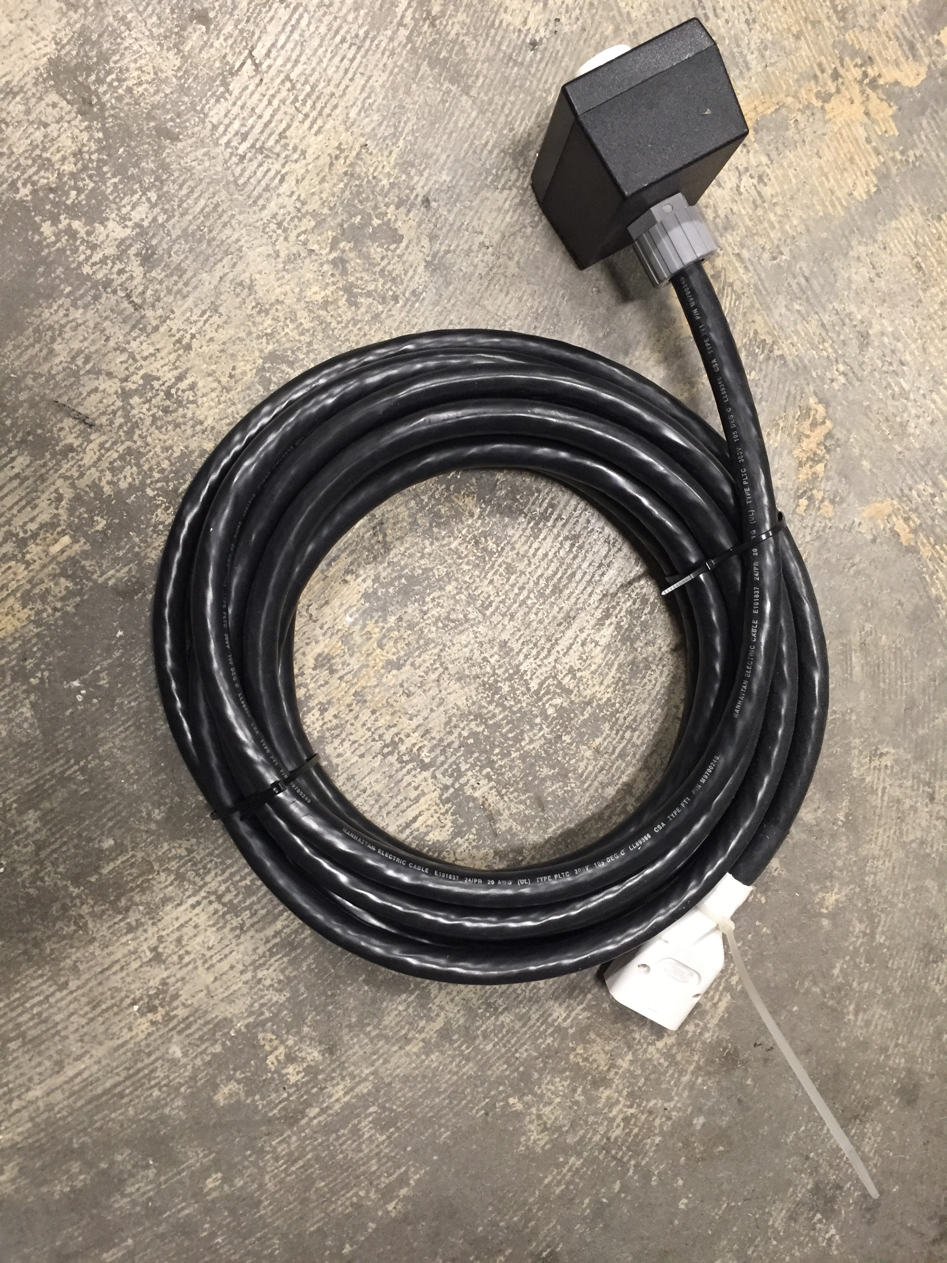
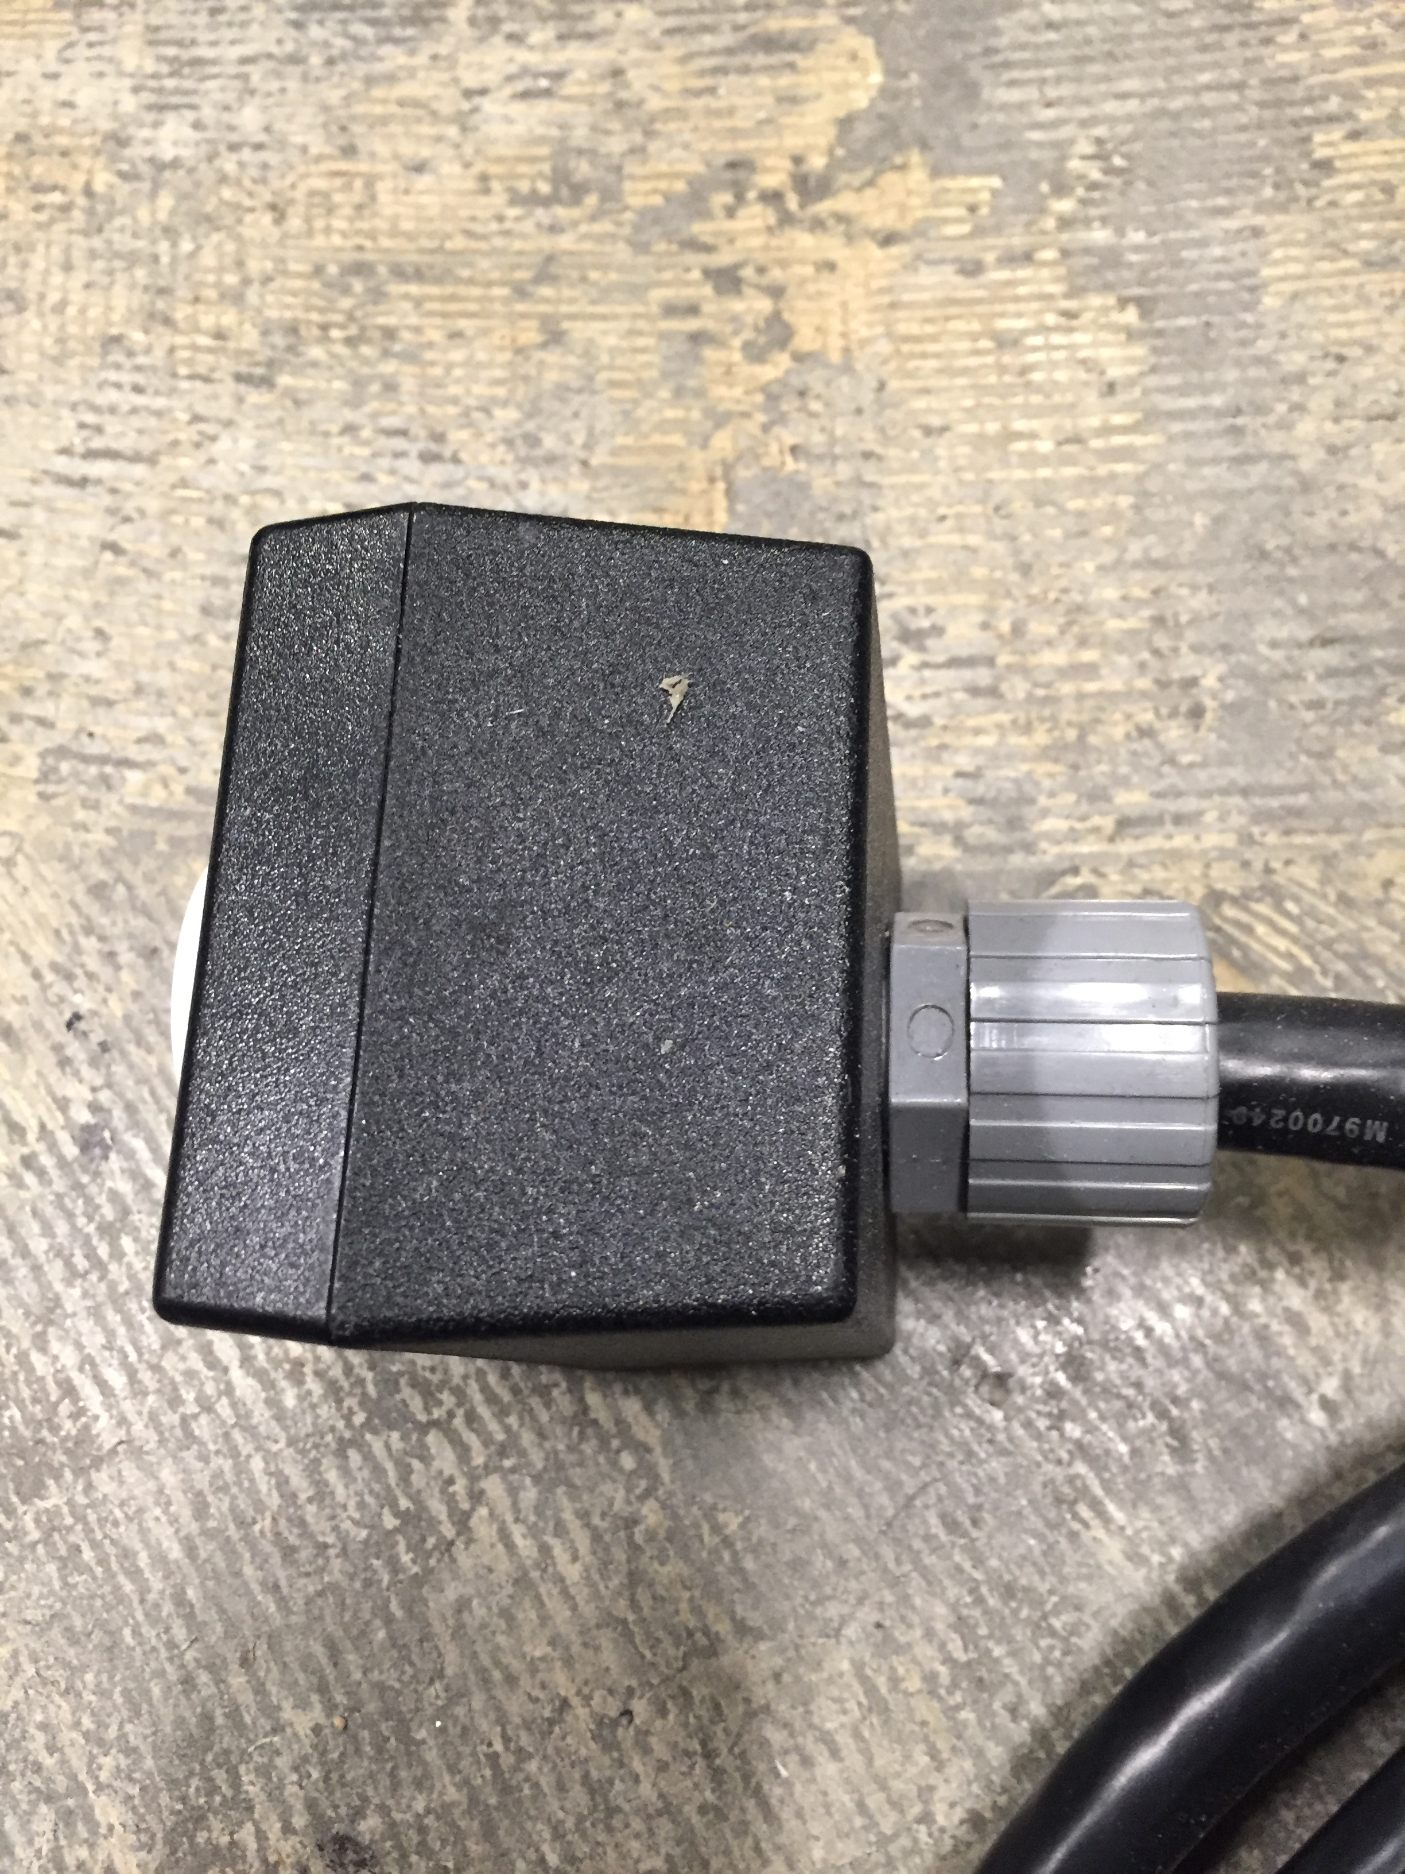
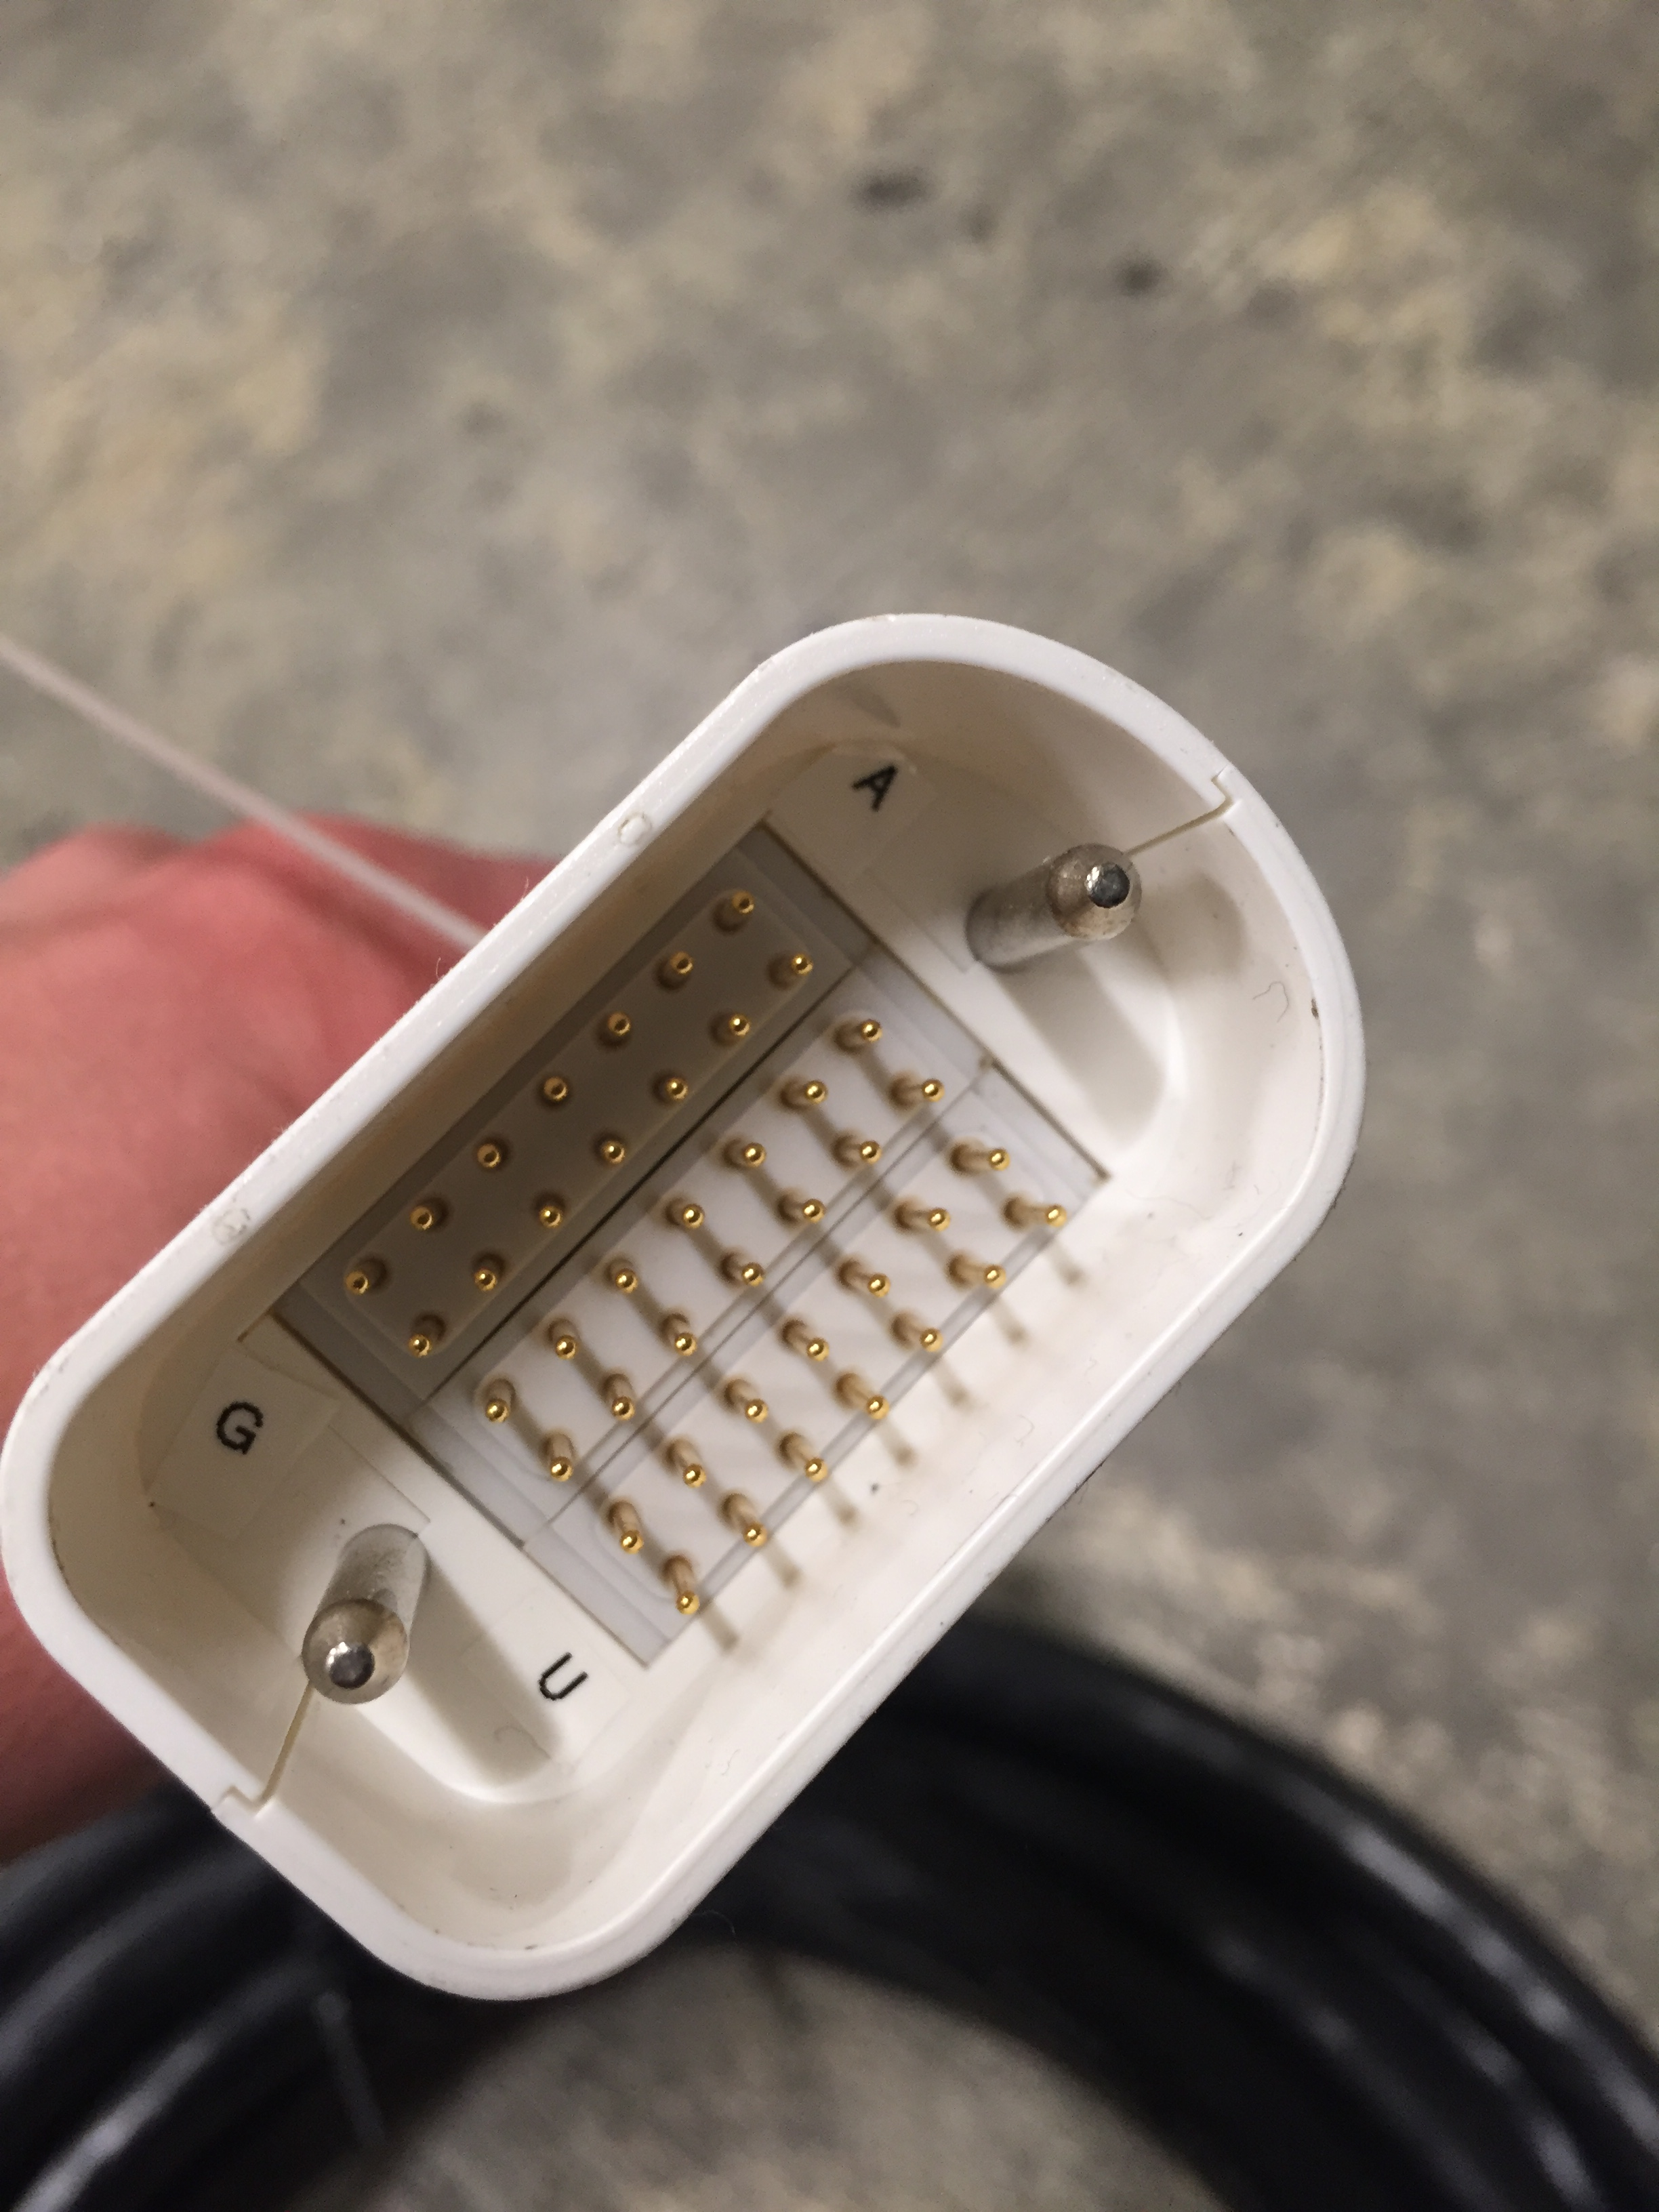
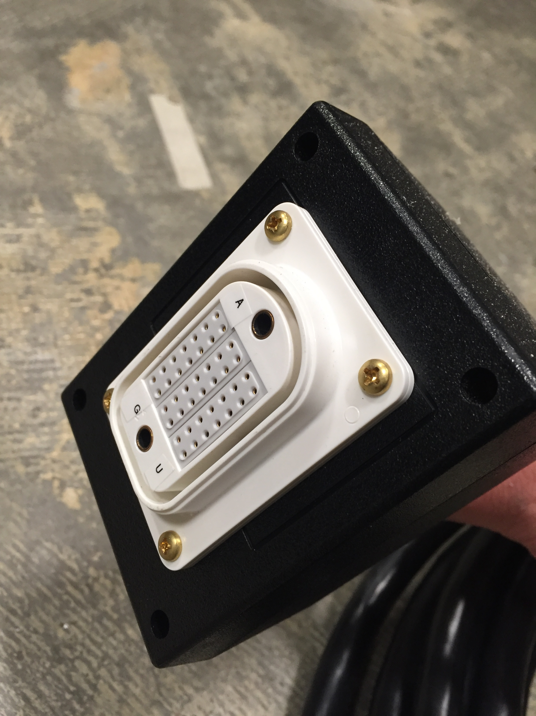
ODU cable for shim channels. Adjacent pins are connected to one twisted pair inside cable. Each shim channel requires a separate return path.
ODU does not provide enclosure for the receptacle so you need to build your own from a box and a gray Hubble cable gland for strain relief

Slide 26
Notes on ODU cables:
Three blocks each with 14 pins = 42 pins total for 21 shim channels.
Each shim channel requires a separate return path. DO NOT CONNECT SHIM CHANNEL RETURN PATHS INTO A COMMON GROUND INSIDE THE SHIM COIL OR INSIDE THE SHIM AMPLIFIER ENCLOSURE.
NOTE: 90-pin versions of this connector are also available from ODU. You can change the inserts to use thinner insulating bodies that have higher pin density. The ODU connector blocks are easily changeable.

Slide 27
Teensy Arduino control software

Slide 28
Teensy Arduino control software: runCRev
In Arduino software, choose: Tools → Board → Teensy 3.5
Then Tools → Port → Teensy port
This is where you set the output current in the runCRev file:
Number of “slices” to update through (for optional dynamic shimming)
Number of shim channels (columns). Can go up to 64ch.
Array of currents in each channel (columns) for each slice/trigger (rows)
Board 0
Board 1
Board 2
Board 3

Slide 29
(2) Click here open serial port dialog box
(1) Click here to compile with Teensy connected

Slide 30
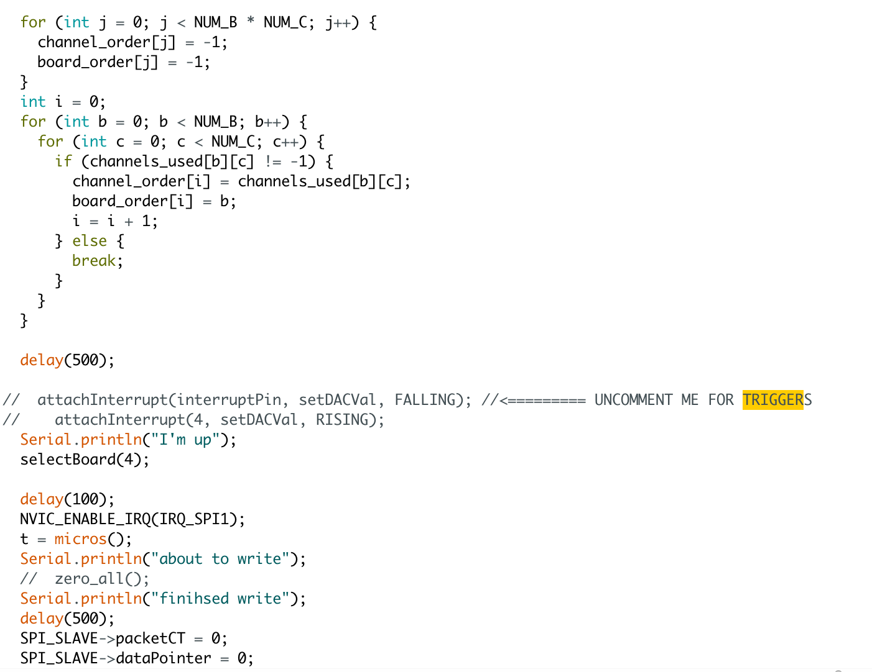
To enable triggering for dynamic shim updating, uncomment this line. Must connect via fiber optic or BNC to scanner trigger output (“SYNC” on Siemens).

Slide 31
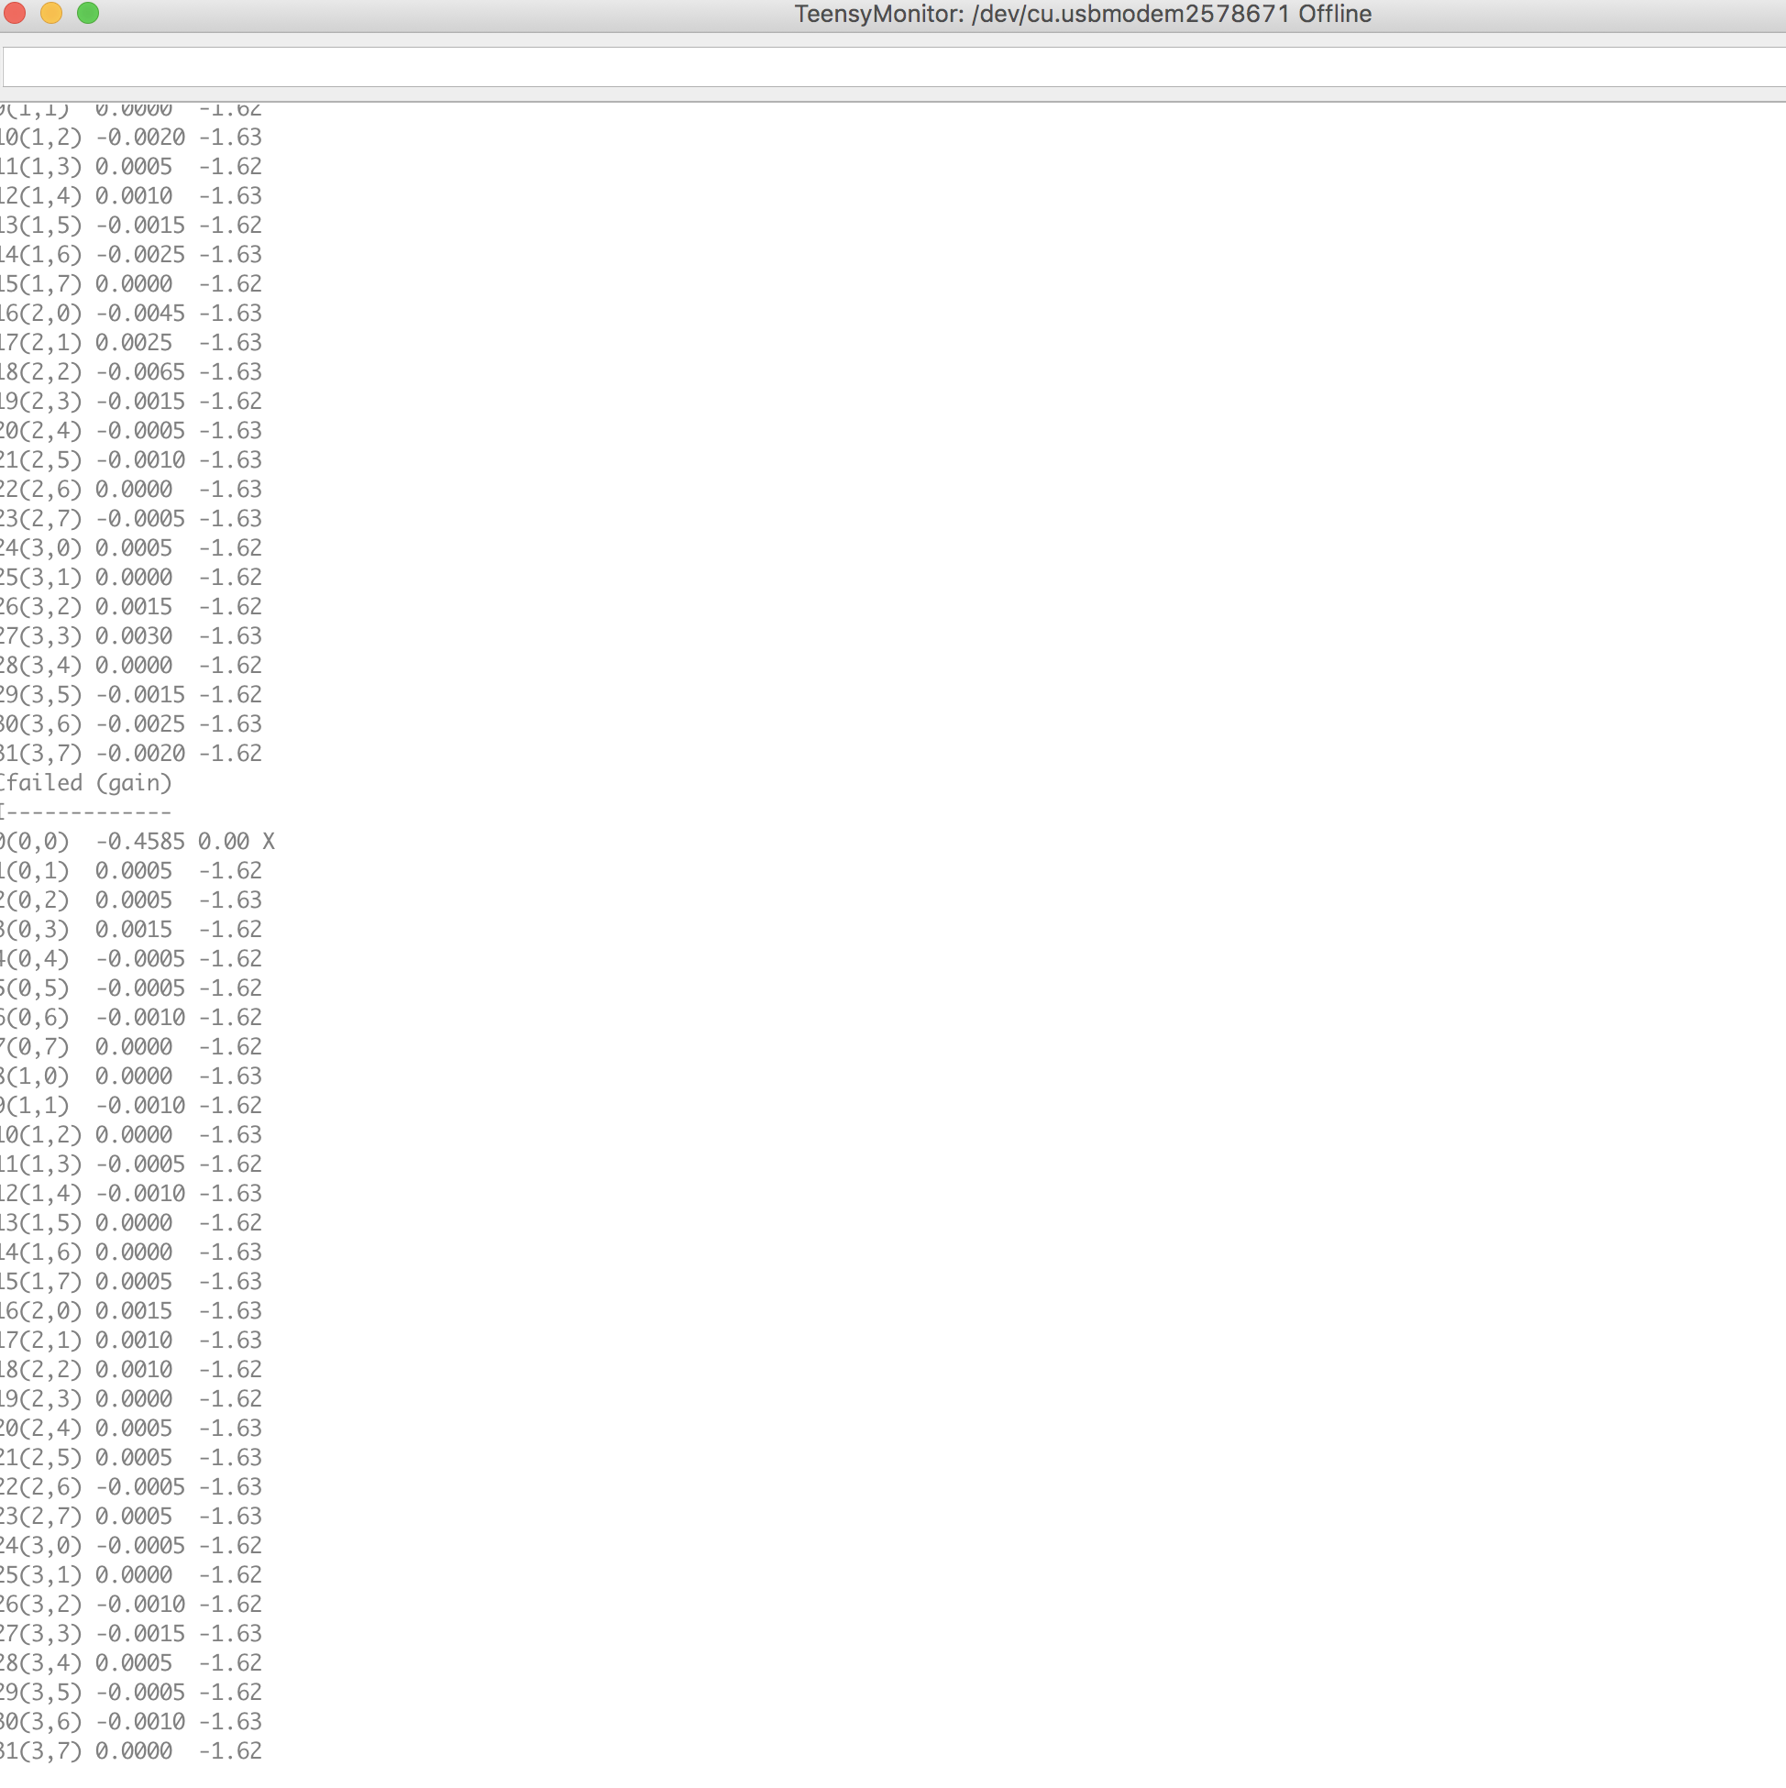
Serial port dialog box.
These four single-characters commands are how you control the Teensy:
“I” to read out currents on each channel
”C” performs auto-calibration to zero currents on each channel
“Z” zeros all channels
“M” loads the first set of shims and ensures that Arduino is in triggered mode
Watch out for channels that fail the auto-calibration! This either means (a) the channel is disconnected, (b) the channel is broken, or (c) the channel is deliberately unused
Outputs:
First column is board and channel addresses
Second column is proportional to the input voltage on each channel
Third column is proportional to ADC output which reads currents sense resistor
Don’t worry too much about the absolute value of these numbers. Just make sure all channels pass auto-calibration step.

Slide 32
Guidelines for dynamic slice-optimized shim updating

Slide 33
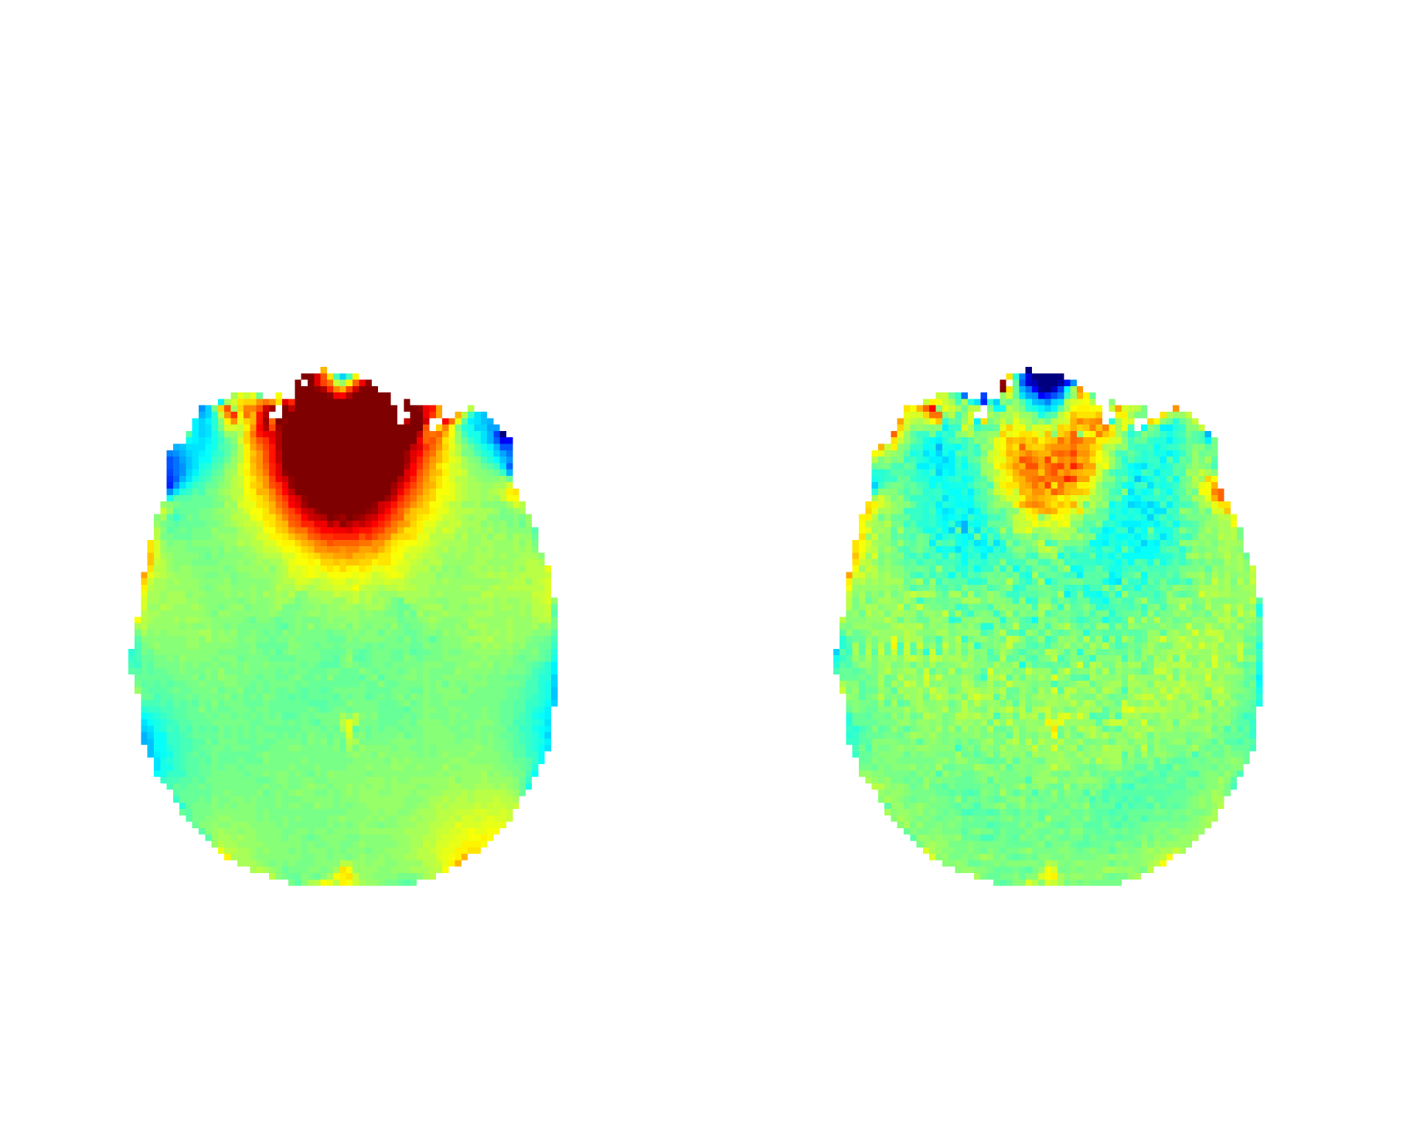
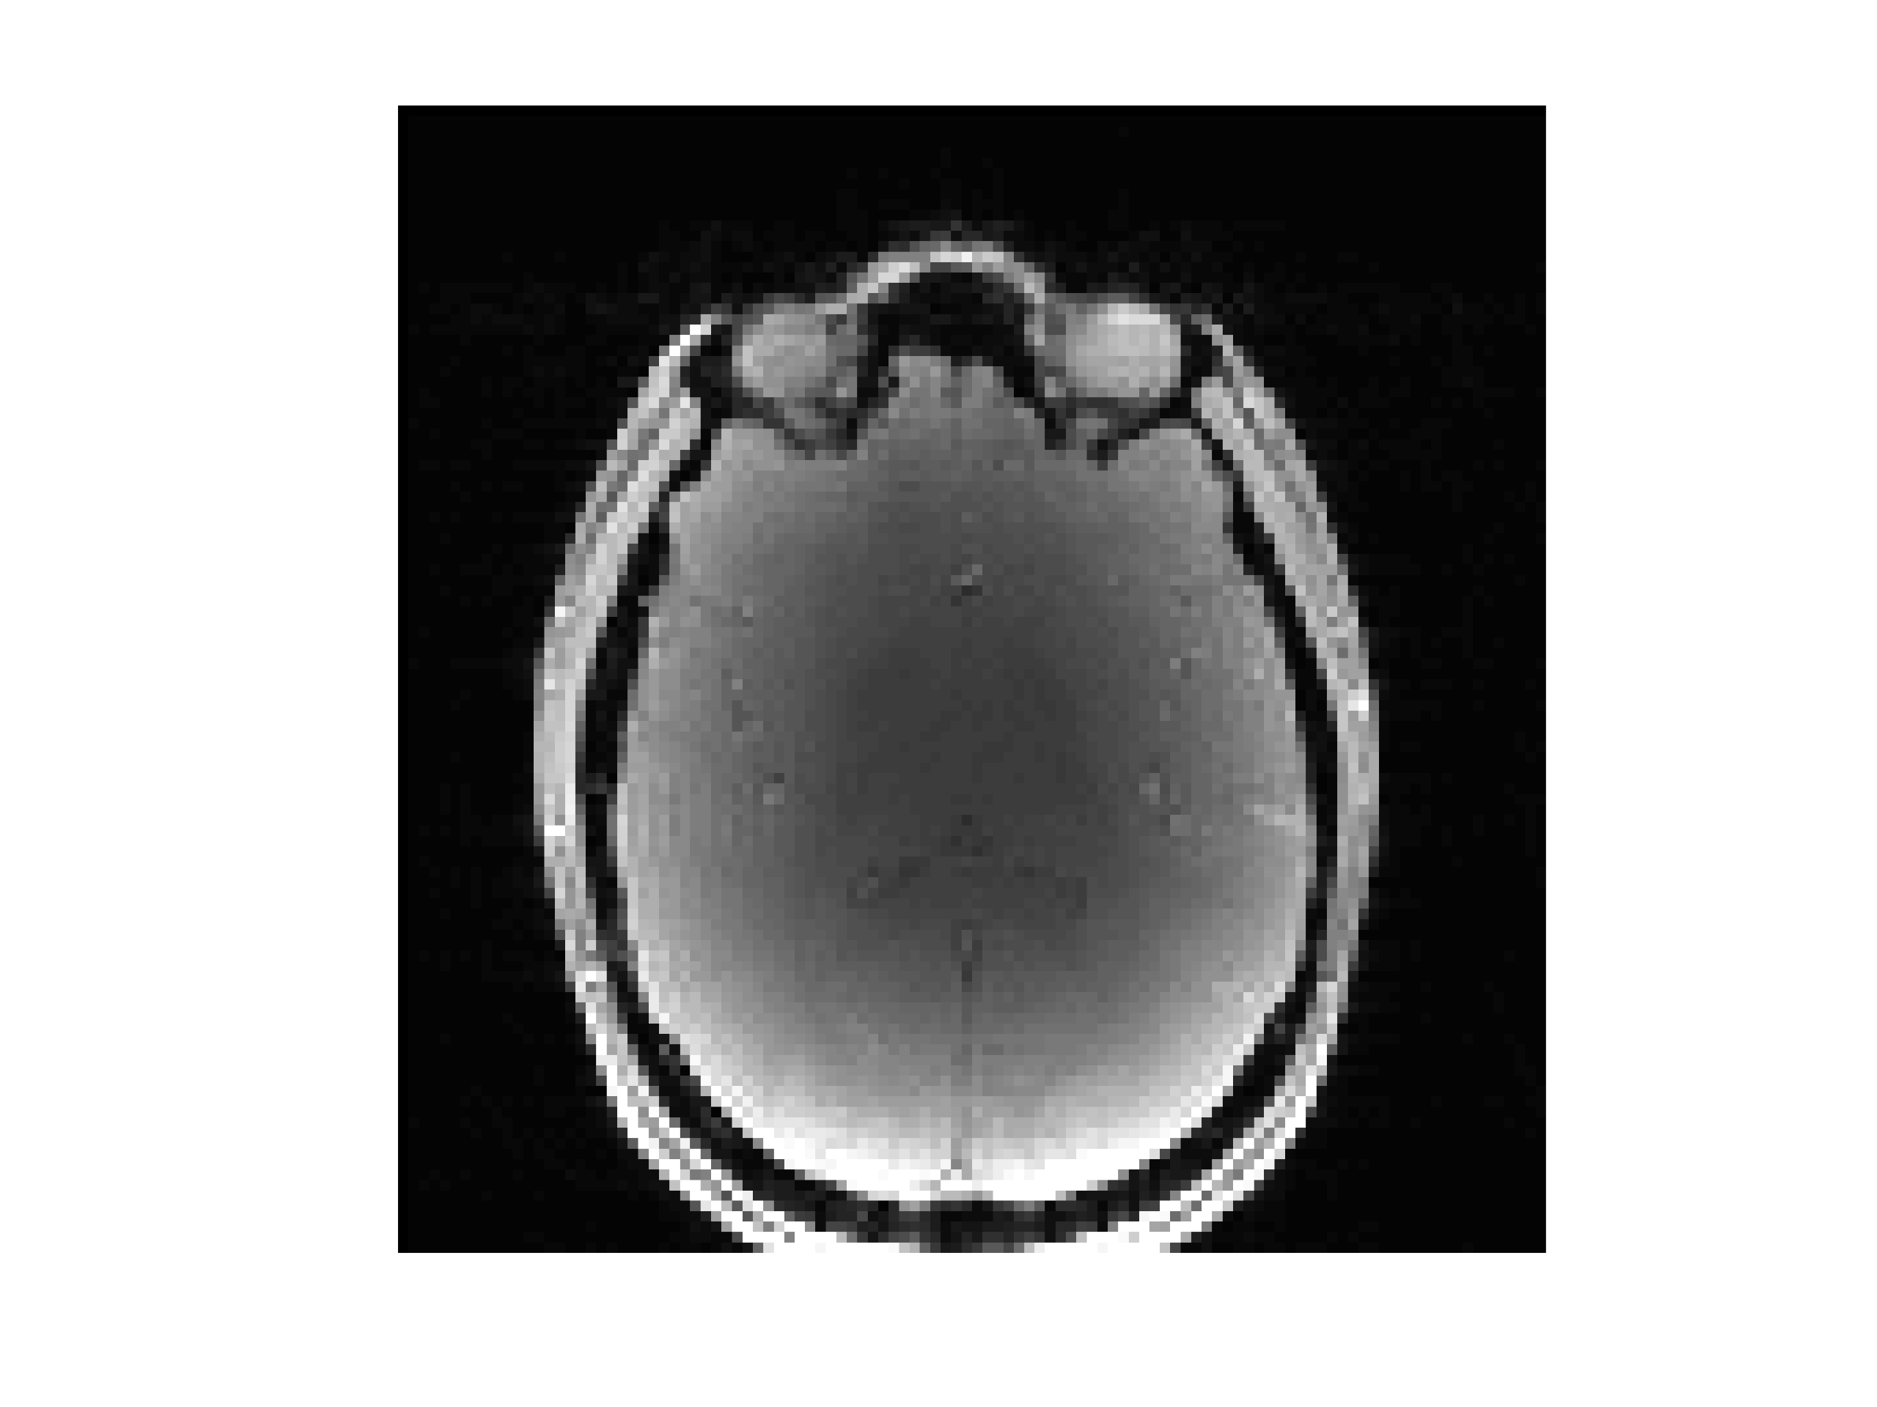
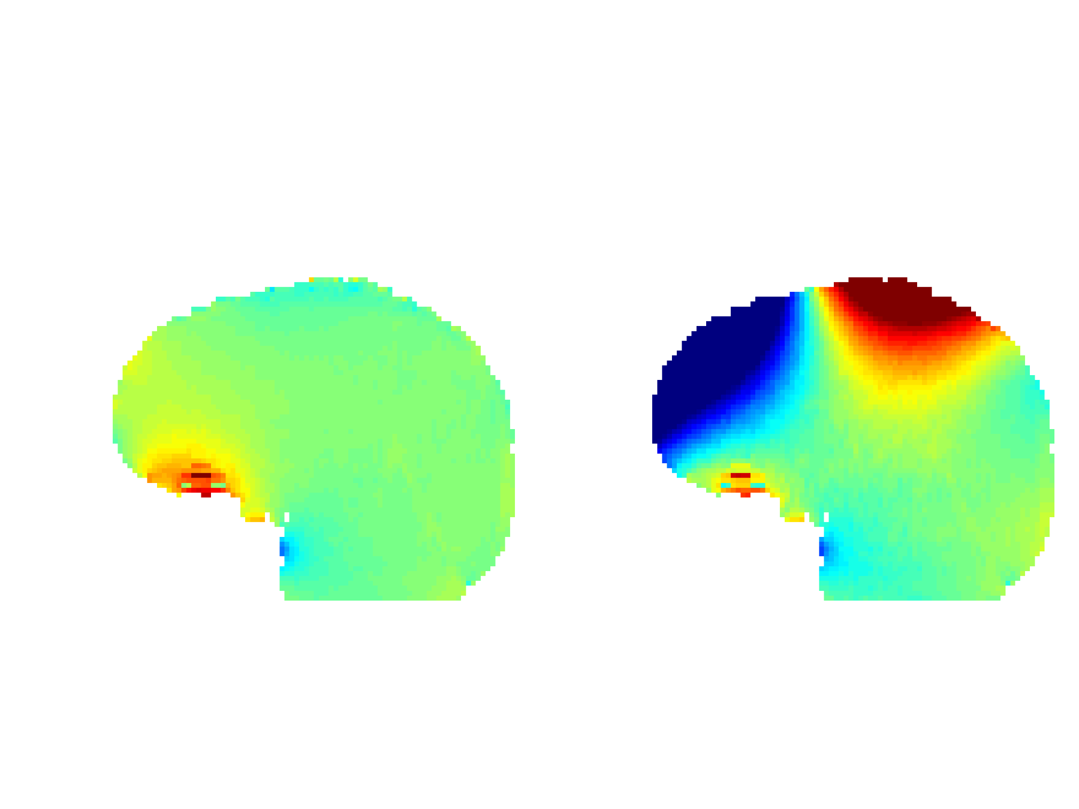
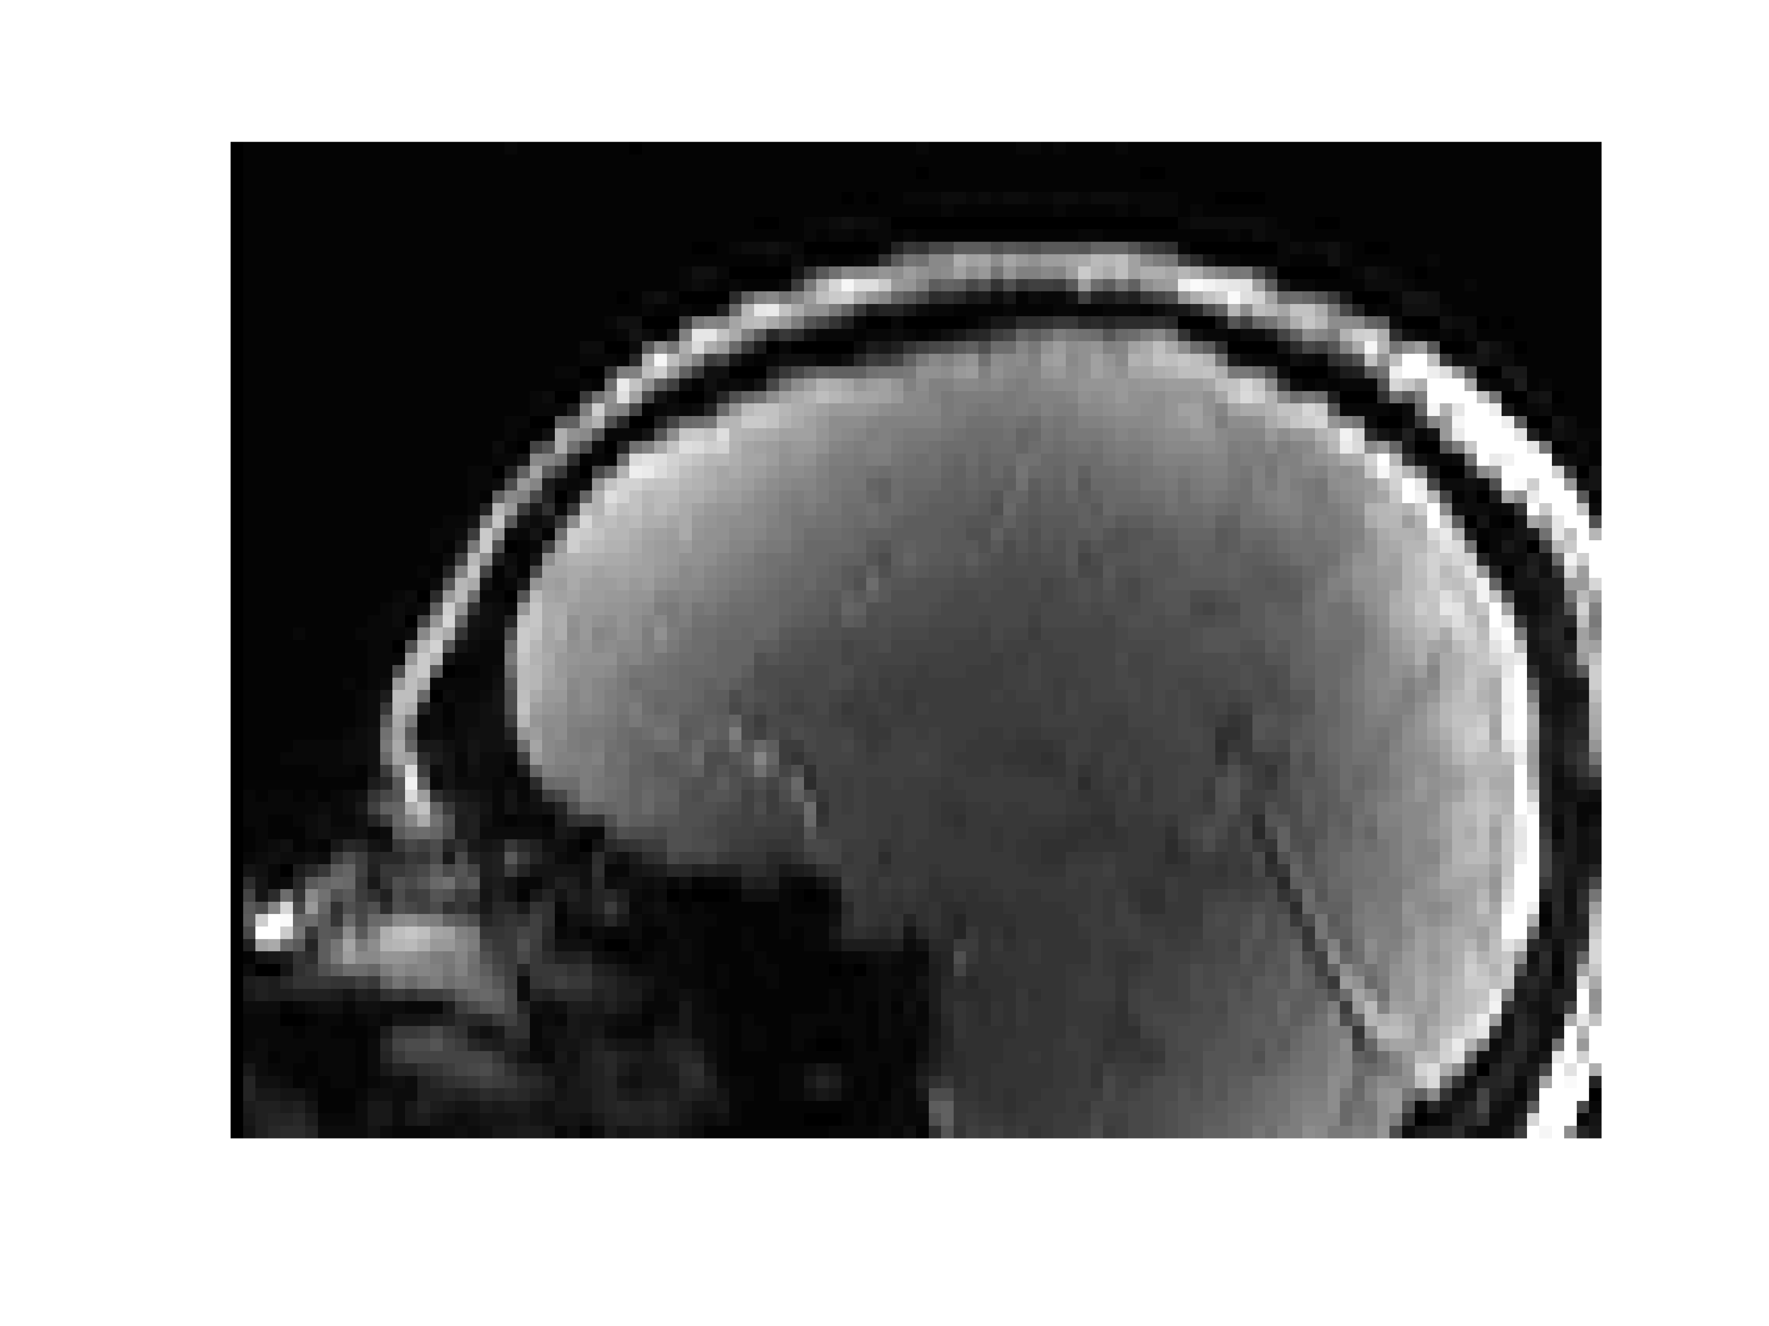
Baseline ΔB₀ map
ΔB₀ map with MC shim field
Delta B0 maps
ΔB₀
Axial
Hz
Sagittal
Fat sat
Hz
Figure. Brain ΔB₀ field maps with and without an applied multicoil shim field offset that is optimized for the 1cm slab bounded in the purple box. While the multicoil field offset improves ΔB₀ homogeneity within the target slice (top right), it creates large field offsets elsewhere in the brain. In parts of the frontal lobes, the multicoil field shifts the water into the saturation band of the fat saturation pulse (-350 Hz lower than water). This leads to spin history effects and reduced contrast when the superior slices of the brain are acquired during subsequent TRs.

Slide 34
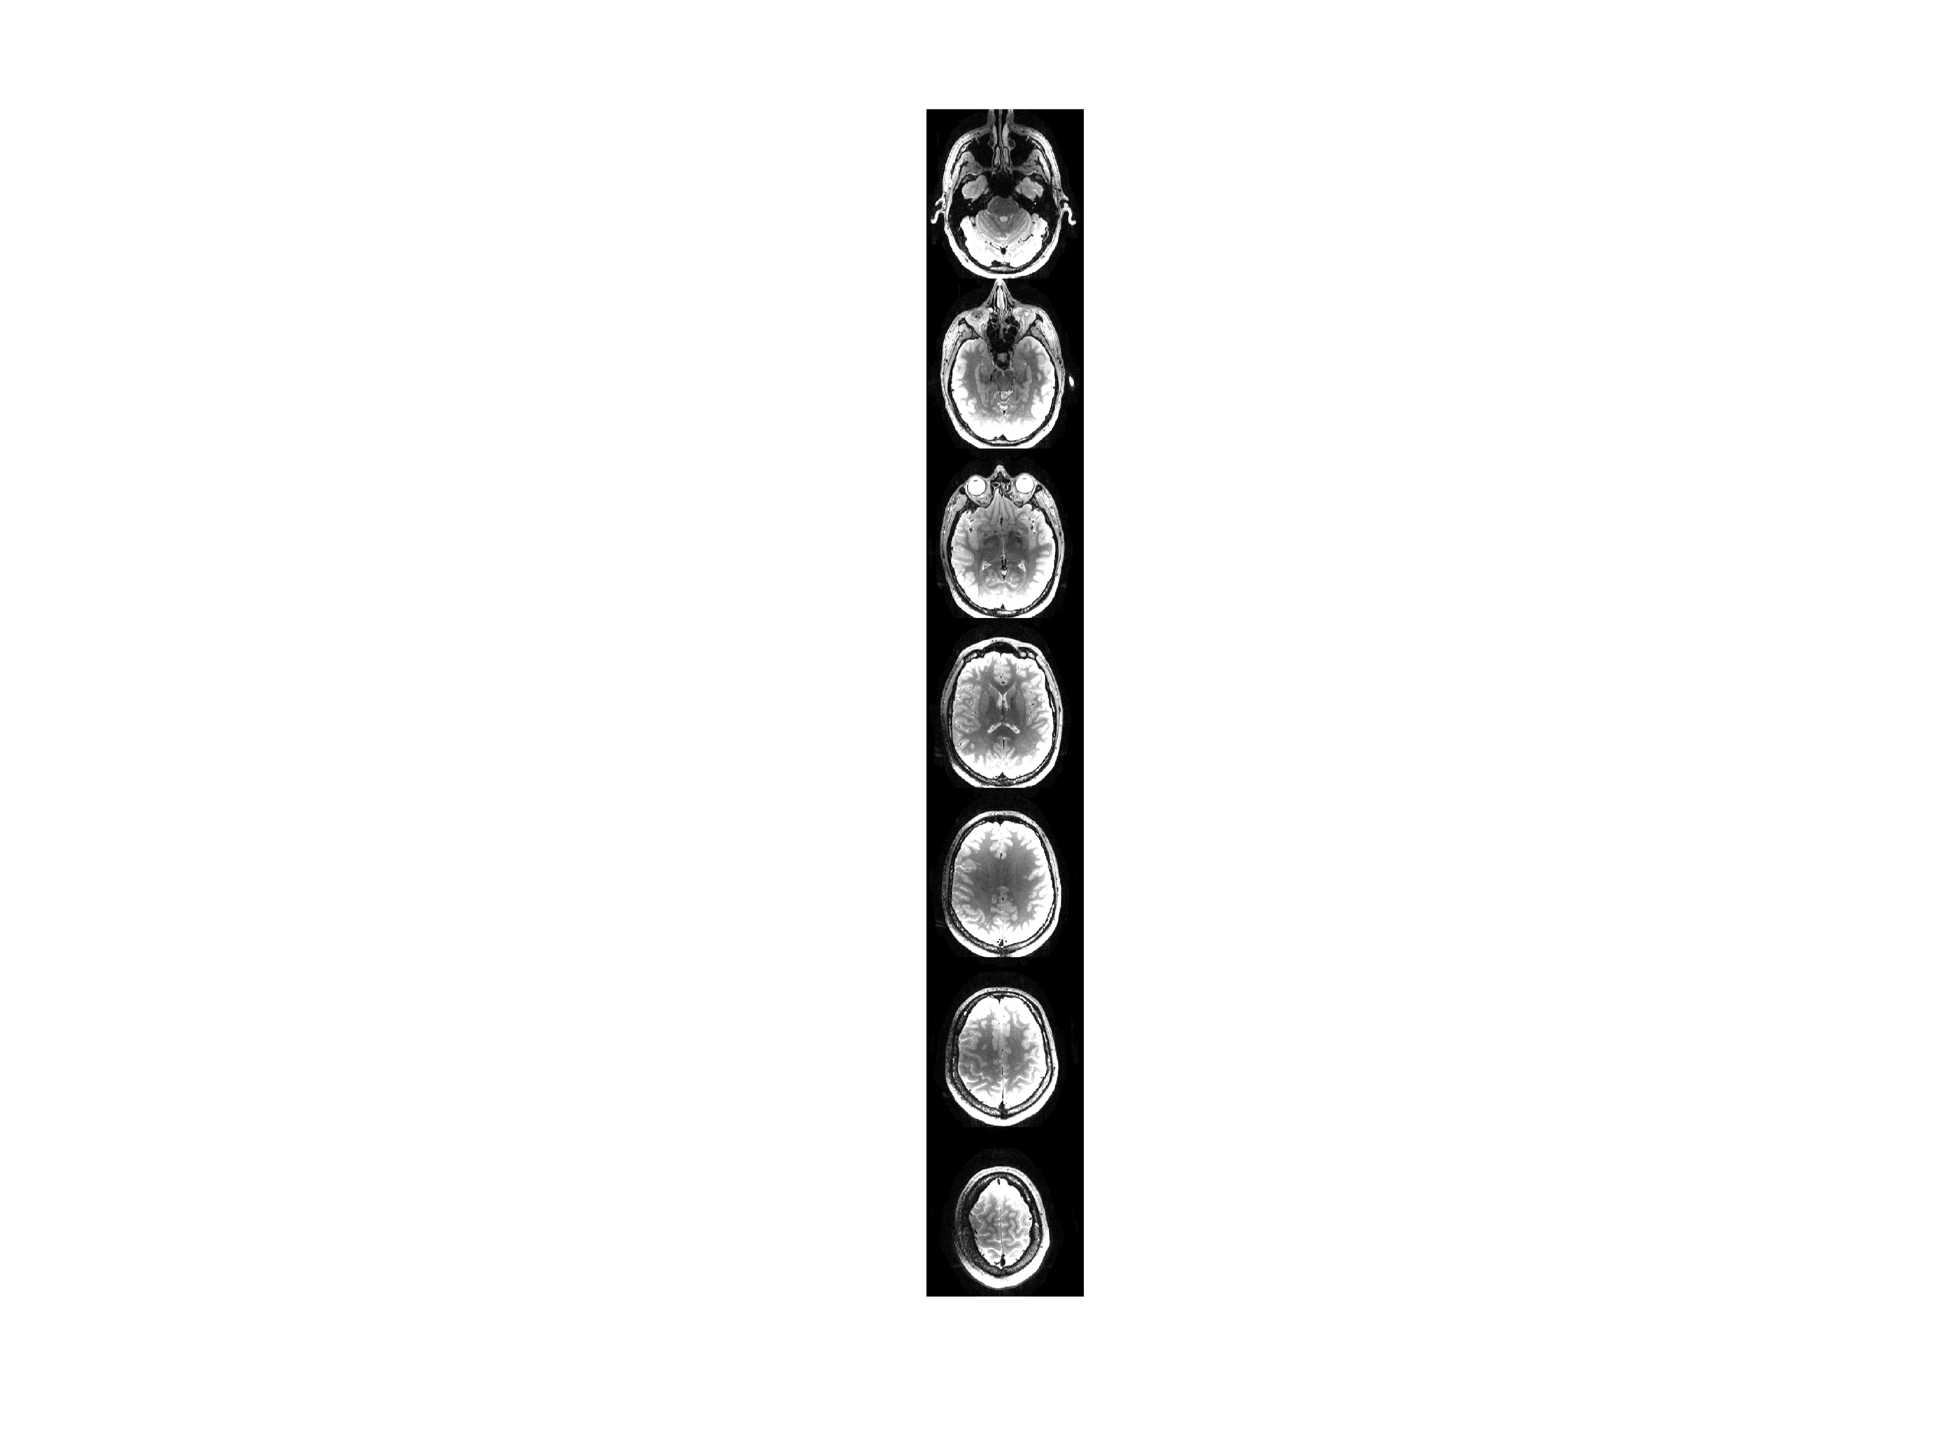
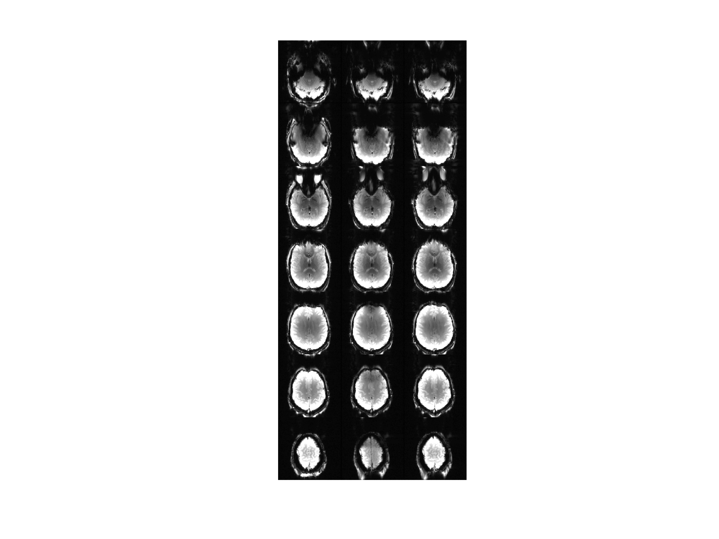
Anatomic
Static shim
Naïve dyn. shim
Optimal dyn. shim
Figure. EPI slices showing loss of contrast due to spin history effects caused by updating the slice-optimized multicoil shim currents before the fat saturation pulse during each TR. The problem is solved by updating to slice-optimized shim currents in between the fat saturation and water excitation pulses, and playing a whole-head global shim during fat saturation. Parameters: Gradient echo EPI, 2x2mm in-plane with 4mm slice, TE=32ms.

Slide 35
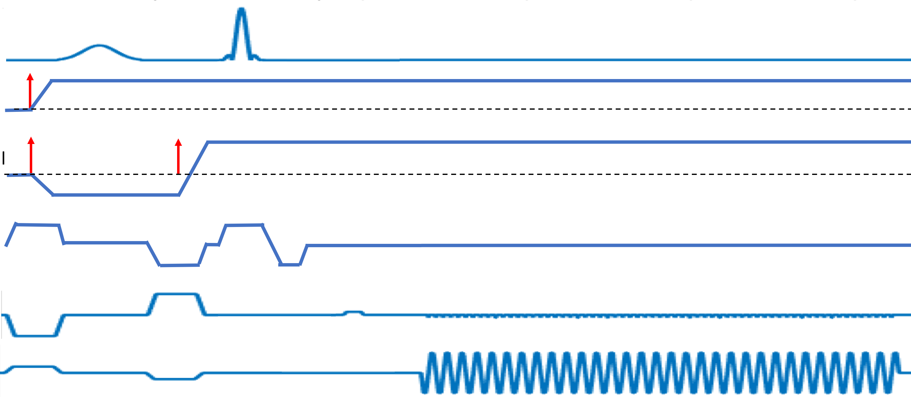
Fat sat
Excitation
RF Tx
Naïve trigger
One shim channel
(slice-optimal shim)
Optimal trigger
(whole-head shim)
Slice select
Phase encode
Readout
Figure. Gradient-echo echo planar imaging sequence showing the “naïve” and optimal triggering schemes for slice-to-slice multi-coil shim updating. Updating to a slice-optimal shim before the fat saturation pulse can lead to severe artifacts due to spin history effects outside the slice being shimmed. Setting the multicoil shims to zero or to a whole-head shim during the fat saturation pulse, and then updating to the slice-optimal

Slide 36
Other artifacts
Subtle artifacts can occur during EPI readouts as the amplifier boards try to compensate for the strong readout gradient slew that induces back-EMF in the shim coils inside the bore. See following slide.
We observed horizontal lines along the readout direction (not PE direction) that seem to come from a k-space disturbance that is periodic in time during even and odd line readouts in EPI
The disturbance may be due to the amplifier ground varying relative to the scanner RF ground, causing a disturbance that is detected by the RF preamps.
The artifact disappears if the two grounds are connected through a capacitor (47nF). Do not directly connect the grounds; only capacitive coupling is permitted. Check with your scanner vendor support engineering or site MR physicist for approval before capacitively-coupling the grounds. We have not had any issues at our site.
This artifact has only been observed on integrated B0/Rx coils where the same loop is used for shimming and RF receive. It may not be a problem for shim-only loops.

Slide 37
Separate grounds
Connected grounds
Image mag. (a.u.)
1000
Standard window
0
Phase-encode direction
GRE-EPI volumes
100
10x window
0
Horizontal line artifact!

Slide 38
Details on board testing
Reproduced from Arango N, ISMRM 2016

Slide 39
Results: Dynamic disturbance rejection
Single-turn test loop
Current driver
15 cm
from isocenter
Position test loop 15 cm from isocenter and oriented for maximum back-EMF caused by EPI readout (z) gradient slewing to maximize flux
3T scanner bore
Sequence parameters: EPI GRE sagittal, 3mm slices ascending, 1.6mm in-plane, matrix 128x128x20, 1302 Hz/pix, 0.94 echo spacing, 6/8 partial Fourier, TE=37 ms, TR=9000 ms
Notes:
READOUT ALONG Z SAY THAT THING creating a large amo

Slide 40
Results: Dynamic disturbance rejection
Position test loop 15 cm from isocenter and oriented for maximum back-EMF caused by EPI readout (z) gradient slewing to maximize flux
Gradient slew disturbance
Single-turn test loop
Current driver
3T scanner bore
Sequence parameters: EPI GRE sagittal, 3mm slices ascending, 1.6mm in-plane, matrix 128x128x20, 1302 Hz/pix, 0.94 echo spacing, 6/8 partial Fourier, TE=37 ms, TR=9000 ms

Slide 41
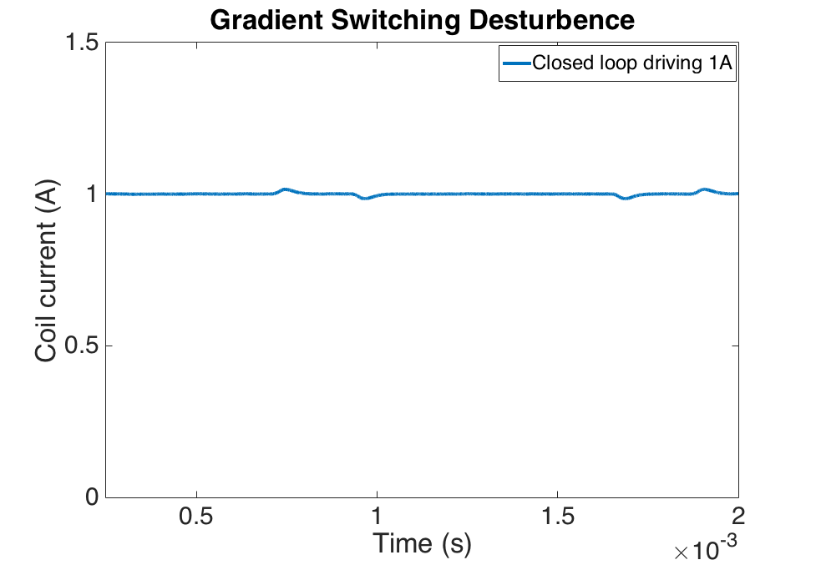
Results: Dynamic disturbance rejection
Closed loop controller rejects gradient slew
Shim current during gradient switching
Single-turn test loop
Current driver
3T scanner bore
Sequence parameters: EPI GRE sagittal, 3mm slices ascending, 1.6mm in-plane, matrix 128x128x20, 1302 Hz/pix, 0.94 echo spacing, 6/8 partial Fourier, TE=37 ms, TR=9000 ms

Slide 42
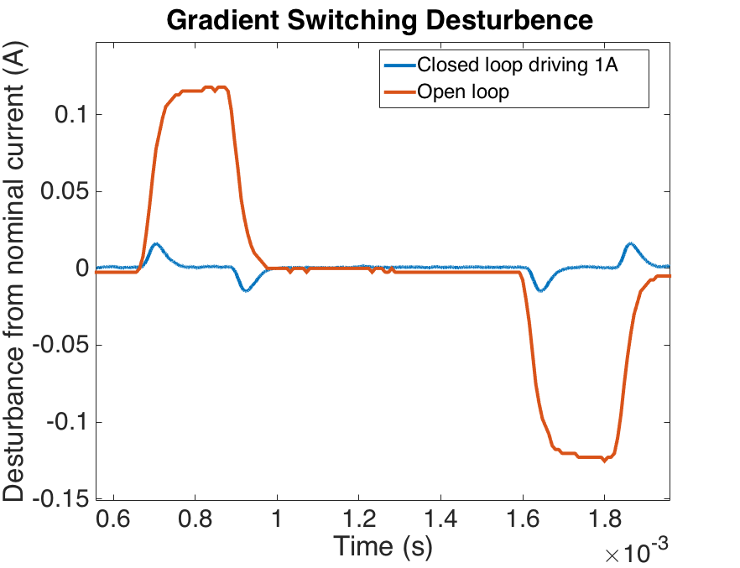
Results: Dynamic disturbance rejection
Closed loop controller rejects gradient slew
Shim current during gradient switching
Single-turn test loop
Current driver
3T scanner bore
Sequence parameters: EPI GRE sagittal, 3mm slices ascending, 1.6mm in-plane, matrix 128x128x20, 1302 Hz/pix, 0.94 echo spacing, 6/8 partial Fourier, TE=37 ms, TR=9000 ms

Slide 43
Results: Shim current can be set 500 𝜇s before image TR
Test: Update shims to +/-2A starting 500us before beginning of TR in EPI-GRE sequence
EPI magnitude images (20 slices)
shim current OFF
SNR = 48.0
shim current ON
SNR = 48.5
a.u.
+2A
0A
-2A
0A
Single-turn test loop
Current driver
Phantom
3T scanner bore
Signal ROI
Noise ROI
Sequence parameters: EPI GRE axial, 3mm slices ascending, 1.6mm in-plane, matrix 128x128x20, 1302 Hz/pix, 0.94 echo spacing, 6/8 partial Fourier, TE=37 ms, TR=9000 ms
Notes:
Shows correct distortion in the phase encode direction

Slide 44
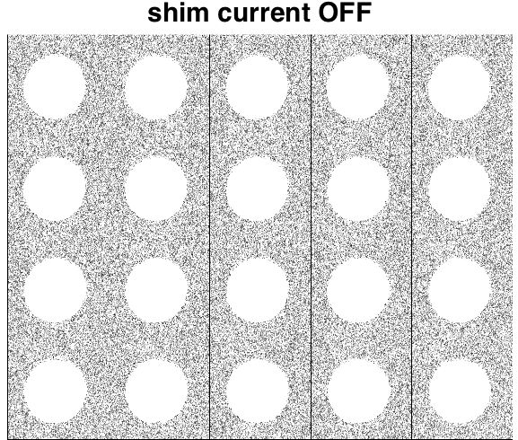
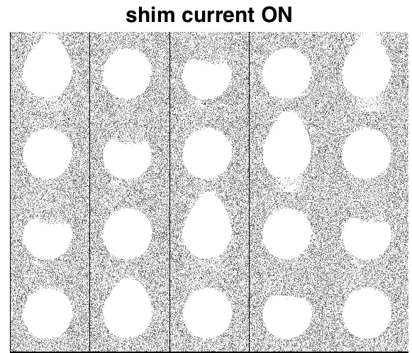
Results: No excess RF noise caused by dynamic shimming
Test: Update shims to +/-2A starting 500us before beginning of TR in EPI-GRE sequence
EPI magnitude images (20 slices)
shim current OFF
SNR = 48.0
shim current ON
SNR = 48.5
a.u.
+2A
0A
-2A
0A
Single-turn test loop
Current driver
Phantom
3T scanner bore
→ No RF “zipper” artifacts or structured noise
Sequence parameters: EPI GRE axial, 3mm slices ascending, 1.6mm in-plane, matrix 128x128x20, 1302 Hz/pix, 0.94 echo spacing, 6/8 partial Fourier, TE=37 ms, TR=9000 ms

